Slide 1

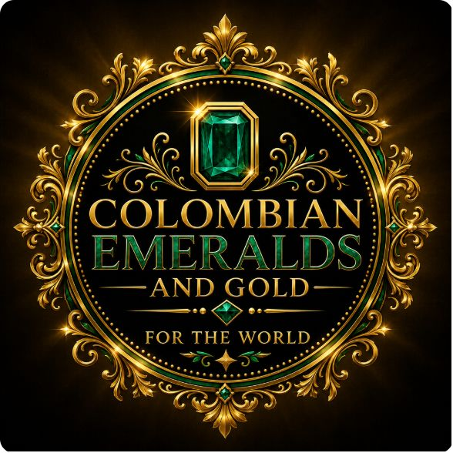
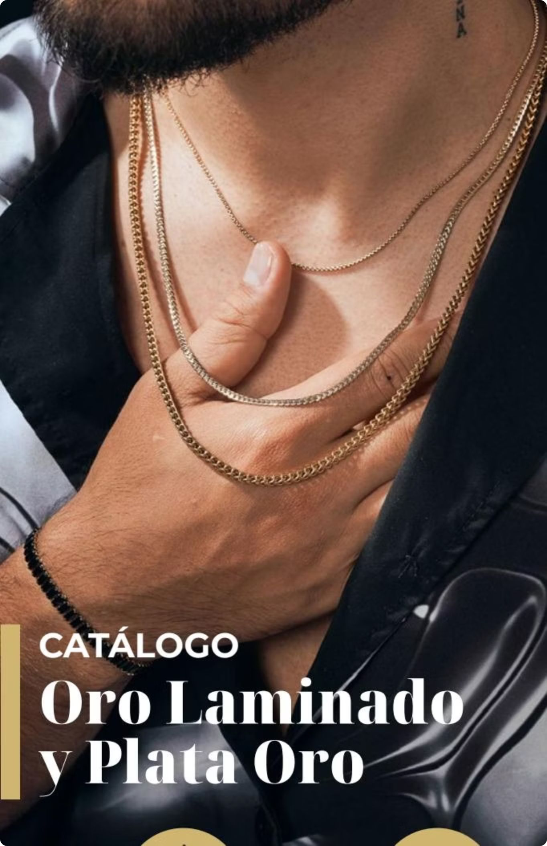



Catalog Gold Plated and Silver Gold
Discover our exclusive collection of 18K gold-plated and gold-silver jewelry — where Italian craftsmanship meets lasting brilliance. Each piece is laboratory-certified and backed by a lifetime guarantee.

Slide 2

What Makes Our Gold Different?
CERTIFIED EXCELLENCE
Not a Plating
Lab Approved
Our process fuses 18K gold onto titanium — creating a hard, permanent bond. Unlike liquid gold baths that chip and fade with friction, our coating endures for life.
Every piece passes a rigorous saline chamber test simulating years of corrosion, friction, and chemical exposure. Results are certified and delivered with your jewelry.
Lifetime Warranty
Identical to Gold
We stand behind every piece unconditionally. Our lifetime guarantee is not a marketing claim — it is a written, laboratory-certified commitment to quality.
Externally, our Oro Laminado is indistinguishable from solid 18K Italian gold — same color, same shine, same texture. The difference is in the value you receive.

Slide 3
Oro Laminado — Frequently Asked Questions
Your Top Questions, Answered
Is it the same as real gold? Externally yes — same 18K color, brilliance, and Italian texture.
Can it be pawned? As a jewel yes, but not as solid gold since it is not solid through.
Is it a bath? No. Baths are liquid and fall off. Our coating is a hard titanium-fused layer.
Does it peel? You can polish it — just avoid sandpaper, which would damage the gold sheet.
Does it resist the sea? Yes — saltwater, pools, lotions, sweat, and acids are no match for it.
We believe you deserve complete transparency before you invest in jewelry. Here are honest, detailed answers to the most common questions about our Oro Laminado technology.

Slide 4




Resistant to Everything Life Throws at It
Our Oro Laminado is engineered for real life. Whether you are at the beach, the gym, or a black-tie event, your jewelry maintains its radiance without compromise.
Lotions & Perfumes
Sweat
Daily skincare routines and fragrances will not dull or damage the gold layer — wear your favorite scent freely.
Workouts and active lifestyles are no problem. Our titanium-fused finish resists the acids found in perspiration.
Pools & Chlorine
Saltwater & Sea
Jump in without hesitation. Chlorinated water will not corrode or discolor our certified gold plating.
The saline chamber test confirms our jewelry withstands prolonged saltwater exposure — perfect for coastal lifestyles.

Slide 5

Lifetime Guarantee — Guaranteed for Life
Every piece in our catalog comes with a laboratory certificate documenting its exact composition and the results of its saline chamber test. This certificate simulates years of corrosion, friction, and acid exposure — confirming your jewelry will maintain its beauty through decades of wear. Our lifetime guarantee is written, certified, and unconditional.
Built to last a lifetime. Certified to prove it.

Slide 6

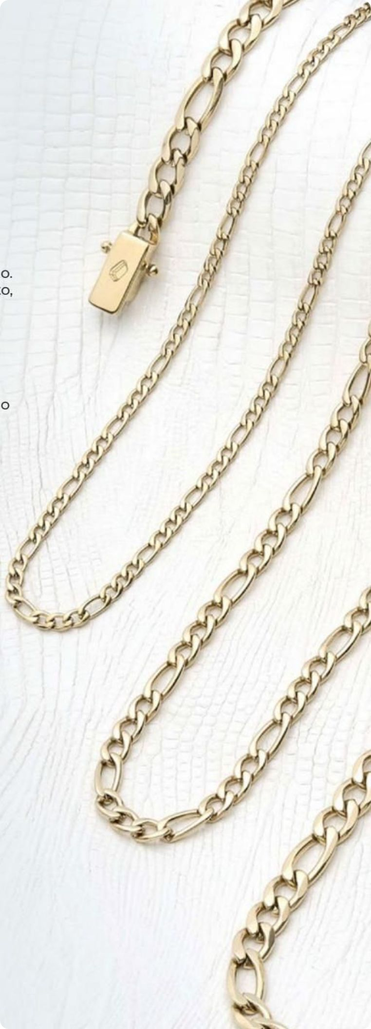
CHAPTER 1
Cadenas — Chain Collection
Our chain collection is the cornerstone of our catalog — a masterful lineup of 18K gold-plated necklaces in every style, from bold Cuban links to delicate Venetian weaves. Each chain is crafted on a titanium base for maximum durability, stamped 18K, and available in multiple widths and lengths to suit every aesthetic. Whether worn alone or layered, our chains make an unmistakable statement.

Slide 7
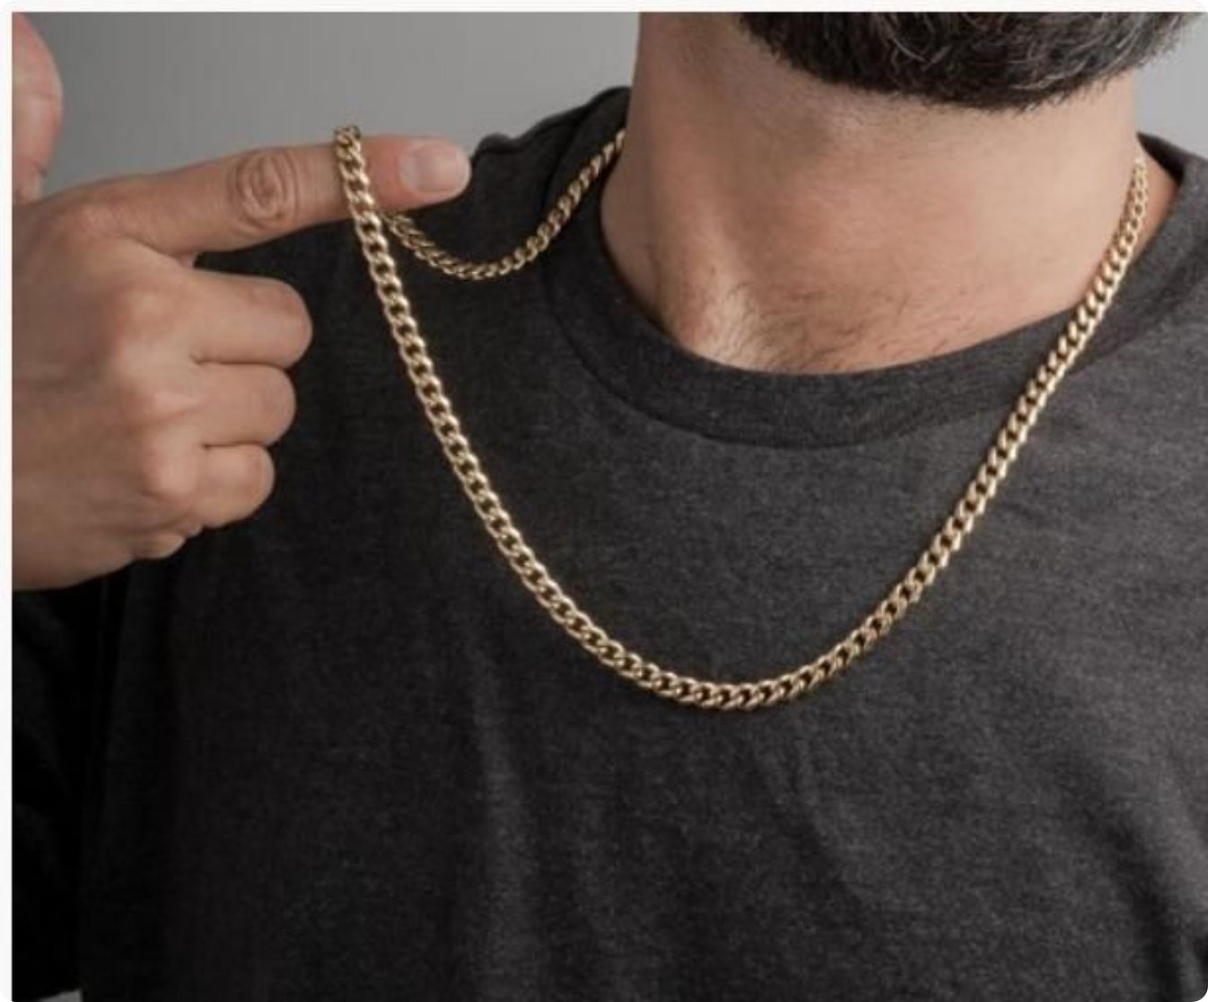
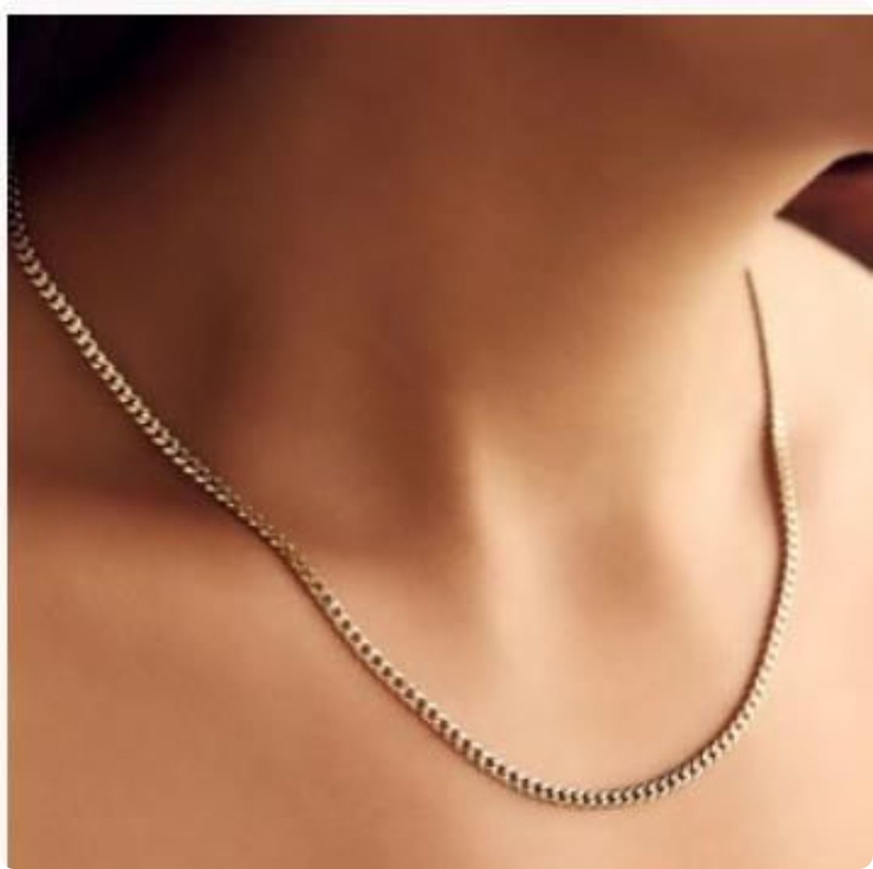
Cadena Cubana
The Cuban link chain is a timeless icon of bold, unapologetic style. Our 18K gold-plated Cadena Cubana features tightly interlocked flat oval links that catch the light from every angle, delivering maximum visual impact. Available in 2mm, 4mm, and 6mm widths — from subtle everyday wear to a commanding statement piece — and in 45cm and 65cm lengths.

Slide 8
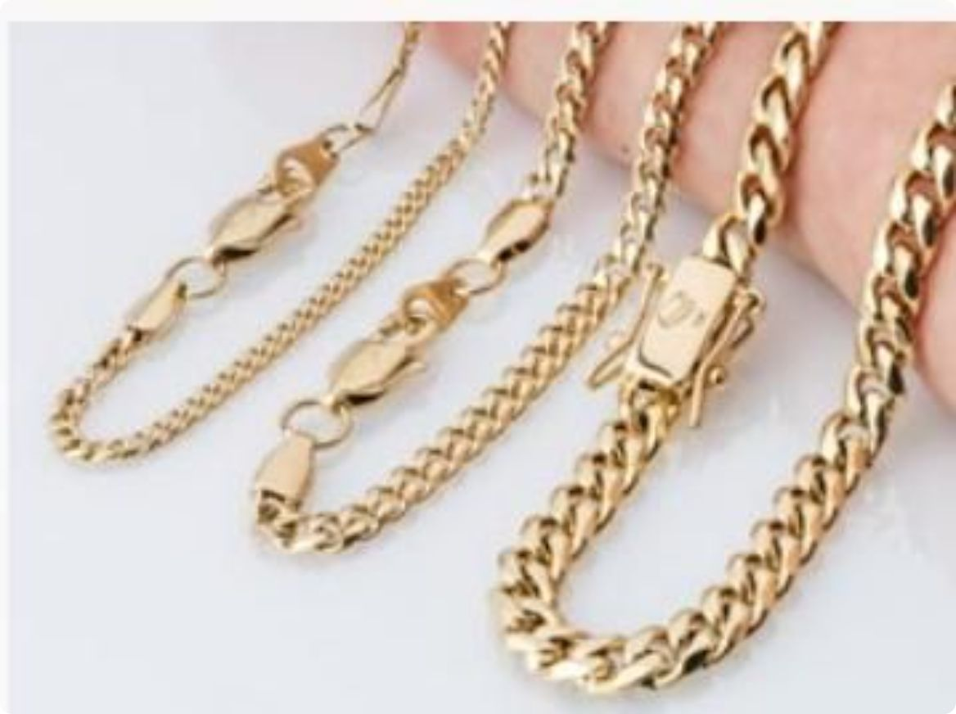

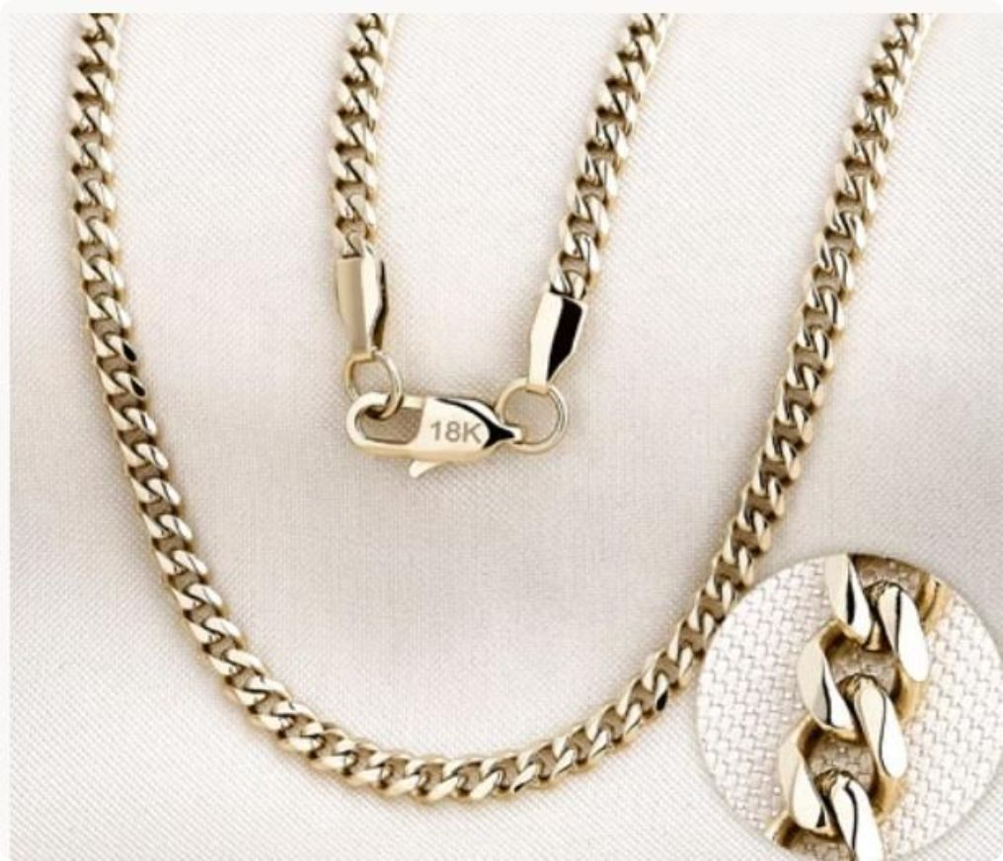
Cubana — Pricing
Size
65 cm
45 cm
2 mm
$150,000
$150,000
4 mm
$200,000
—
6 mm
$290,000
—
All chains are stamped 18K and include a lifetime guarantee certificate.

Slide 9
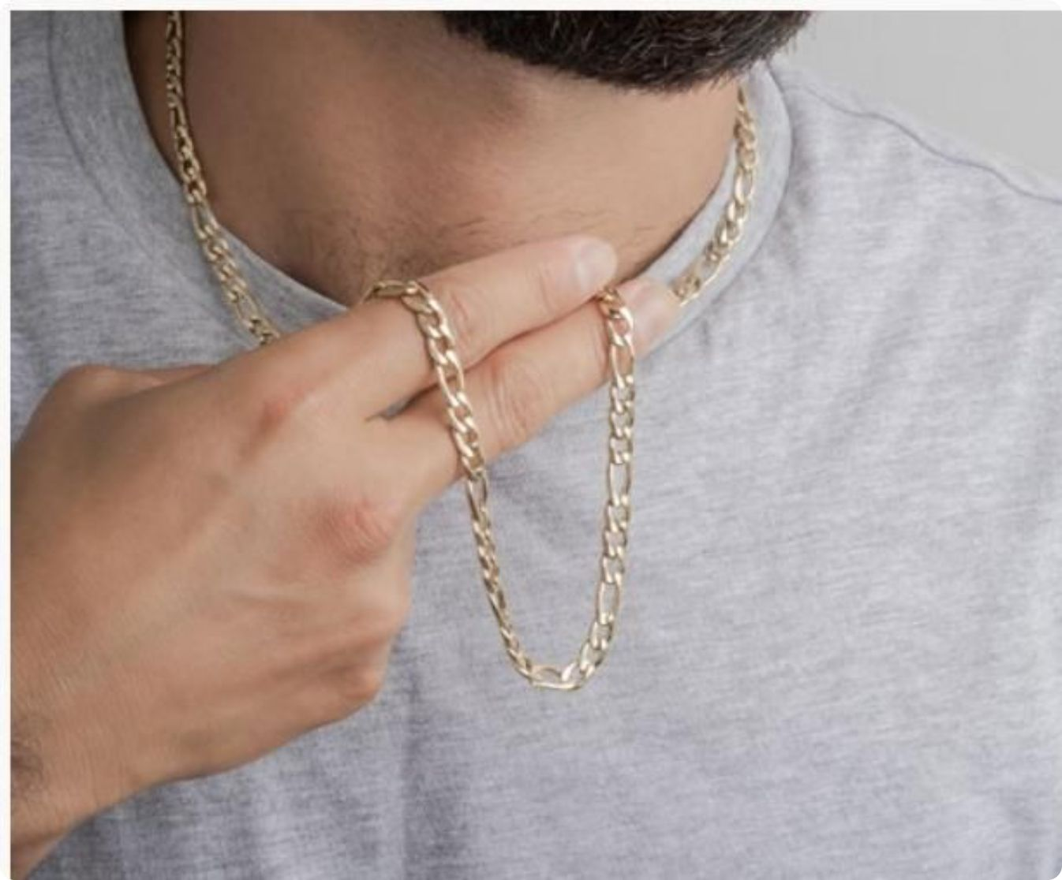
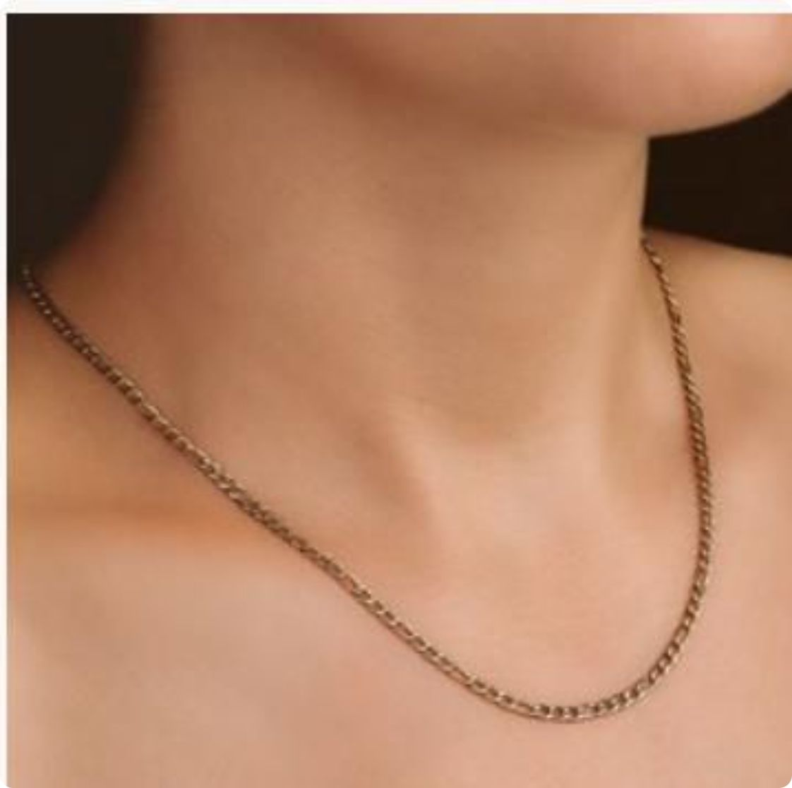
Carter Chain
The Carter chain delivers refined elegance with its distinctive alternating flat and twisted links. This design creates a beautiful play of light and shadow along the neckline, making it equally at home with casual outfits and formal wear. A perennial favorite for both men and women who appreciate understated sophistication.

Slide 10
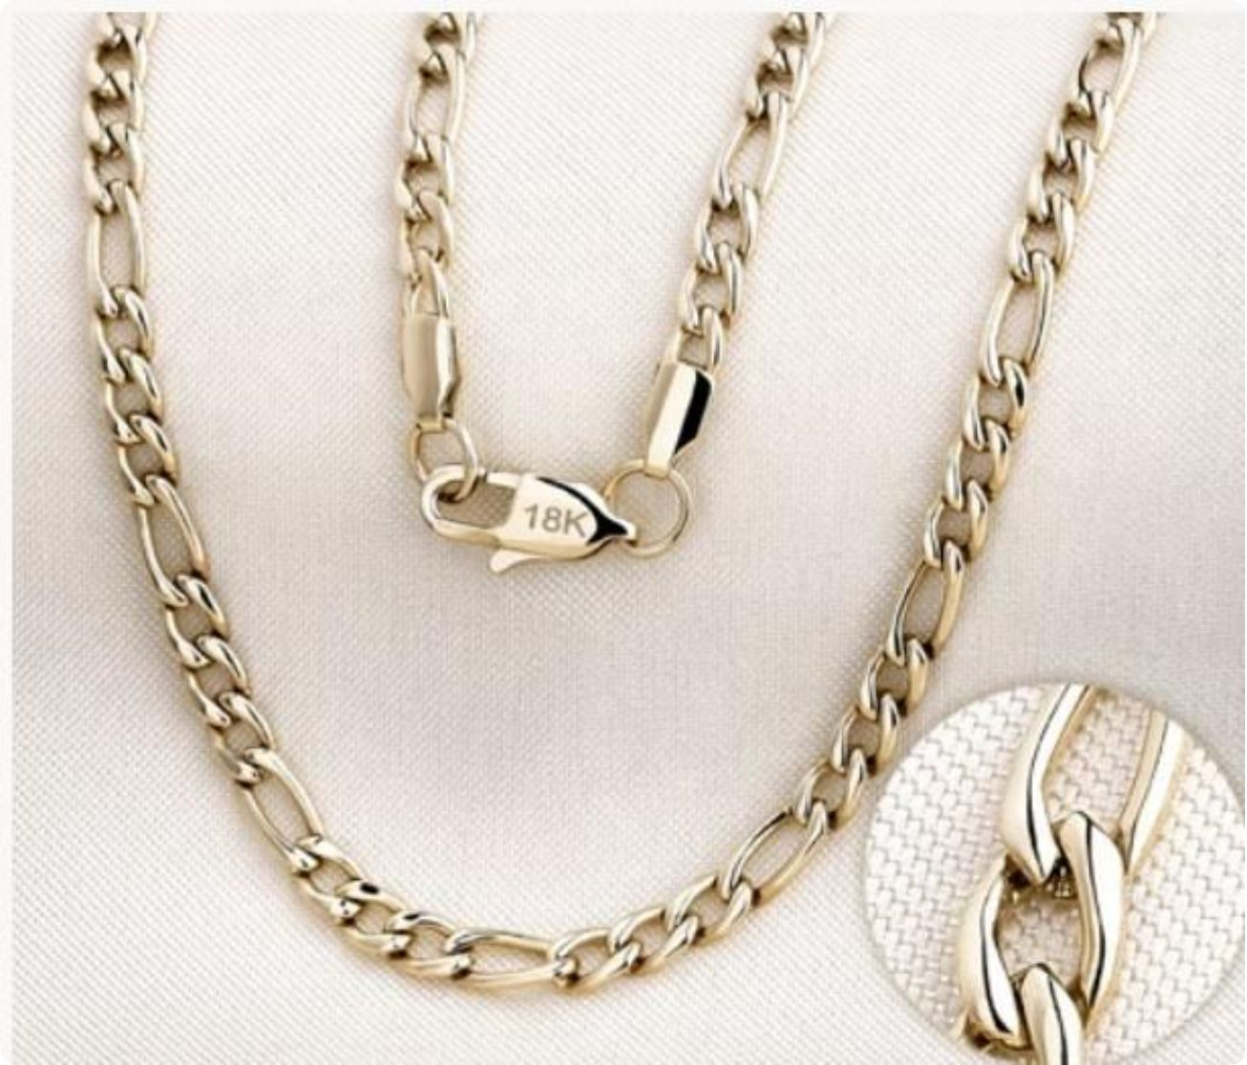
Carter — Pricing
Size
65 cm
45 cm
2 mm
$150,000
$150,000
4 mm
$200,000
—
6 mm
$290,000
—

Slide 11
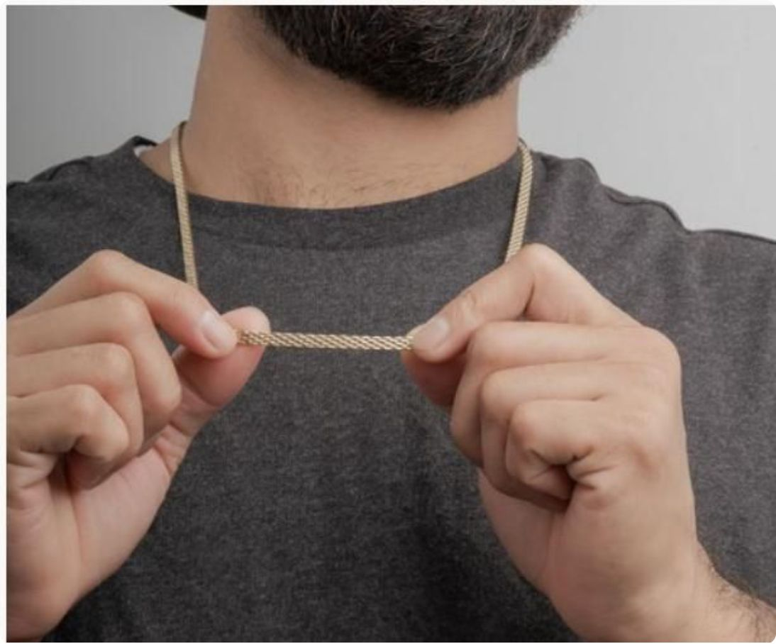
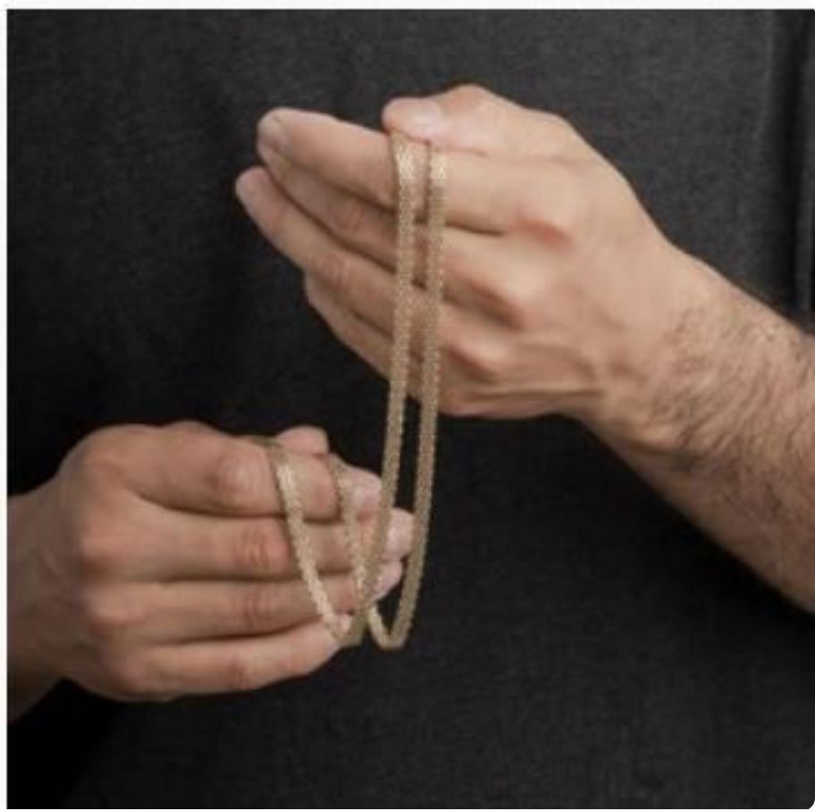
Chinesca Chain
Inspired by traditional Far Eastern weaving techniques, the Chinesca chain features a complex interlocking pattern that gives it remarkable flexibility and a rich, textured appearance. When worn, it drapes beautifully against the skin and catches light with every movement — a true conversation piece for those who value artistry in their accessories.
Chinesca — Pricing
Size
65 cm
4 mm
$200,000
6 mm
$290,000

Slide 12
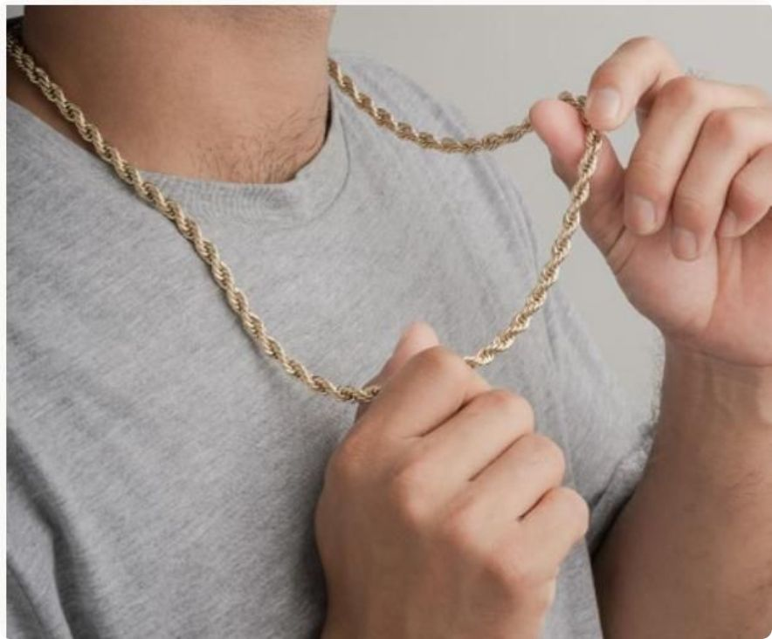
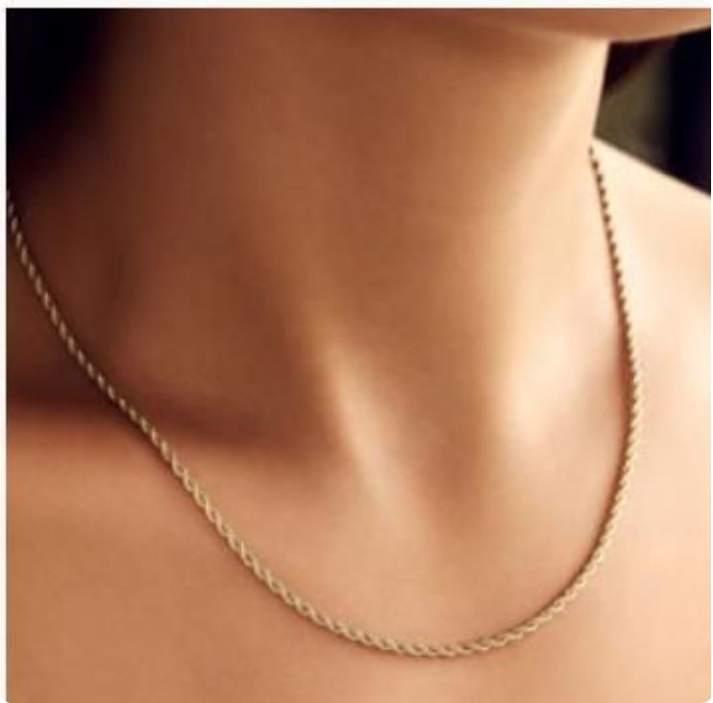
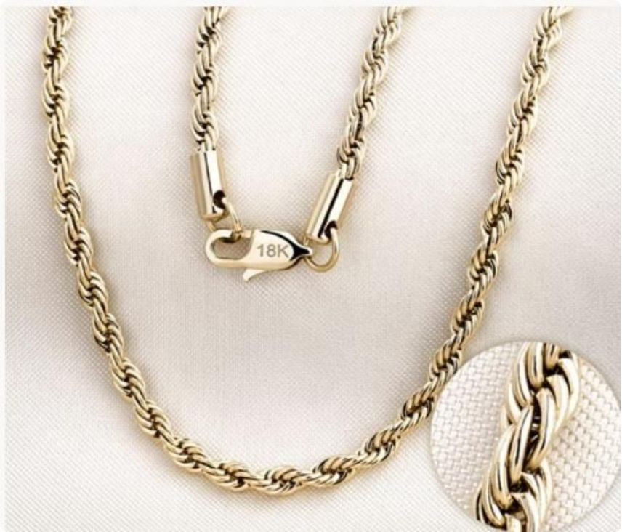
Cadena Lazo (Rope)
The Lazo — or rope chain — is an enduring classic. Its tightly braided strands twist together to create a helical pattern that gleams brilliantly under any light. Robust yet graceful, the Lazo is a versatile anchor piece for any jewelry collection, worn solo for a clean look or layered for maximum impact.
Lazo — Pricing
Size
65 cm
45 cm
2 mm
$150,000
$150,000
4 mm
$200,000
—
6 mm
$290,000
—

Slide 13
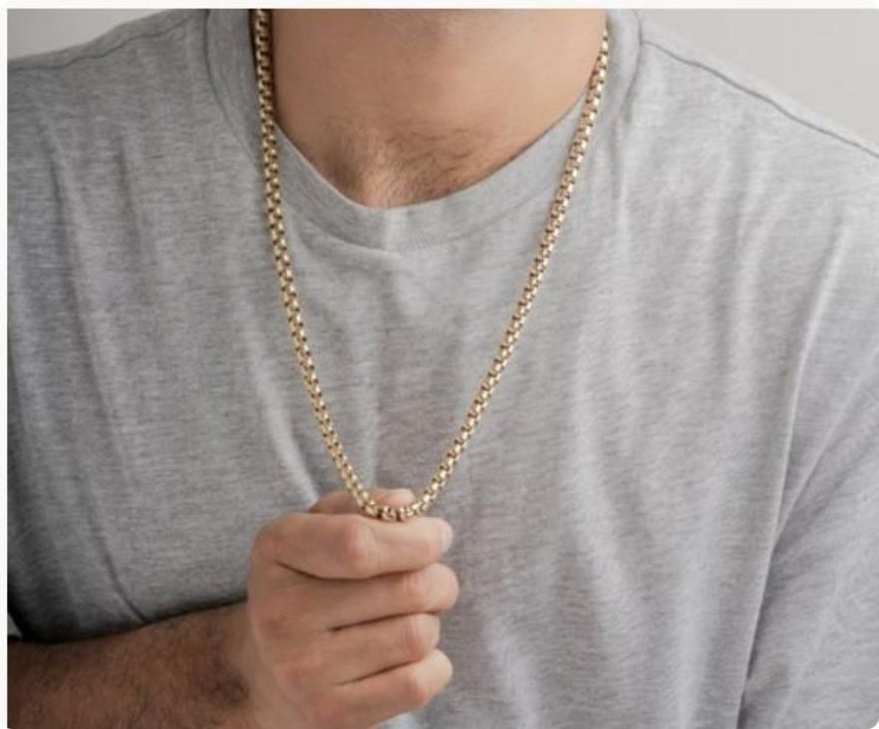
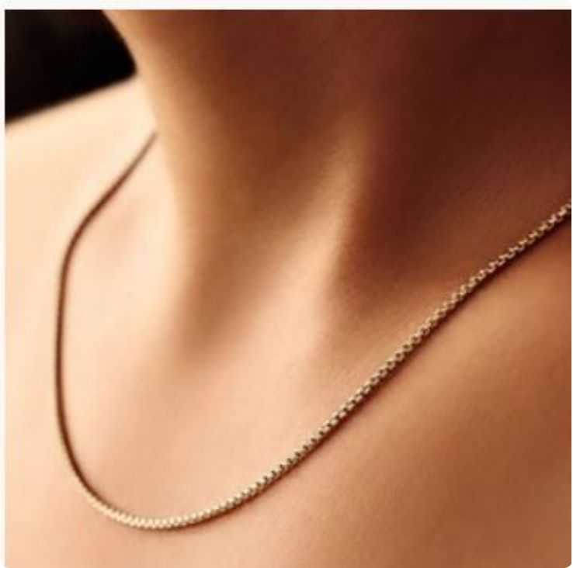
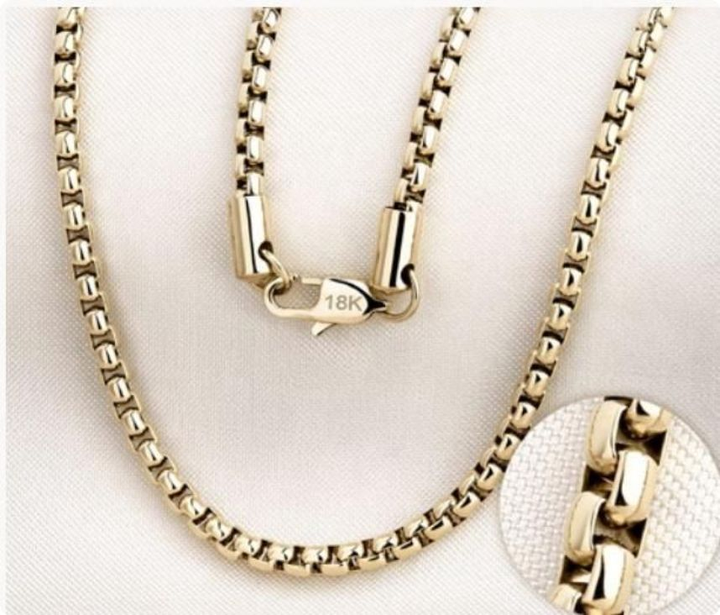
Cadena Veneciana
The Venetian chain is a study in delicate sophistication. Its square box-links form a smooth, structured silhouette that lies perfectly flat against the chest. Originating from the jewelers of Venice, this style is celebrated for its geometric precision — available in ultra-fine 1mm for the most subtle elegance, up to 6mm for a bolder statement.
Veneciana — Pricing
Size
65 cm
45 cm
1 mm
—
$130,000
2 mm
$150,000
$150,000
4 mm
$200,000
—
6 mm
$290,000
—

Slide 14
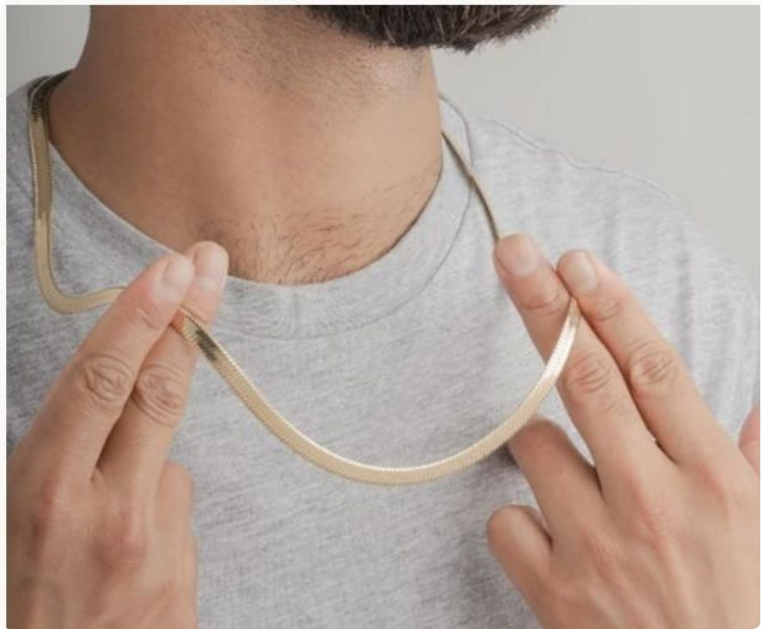
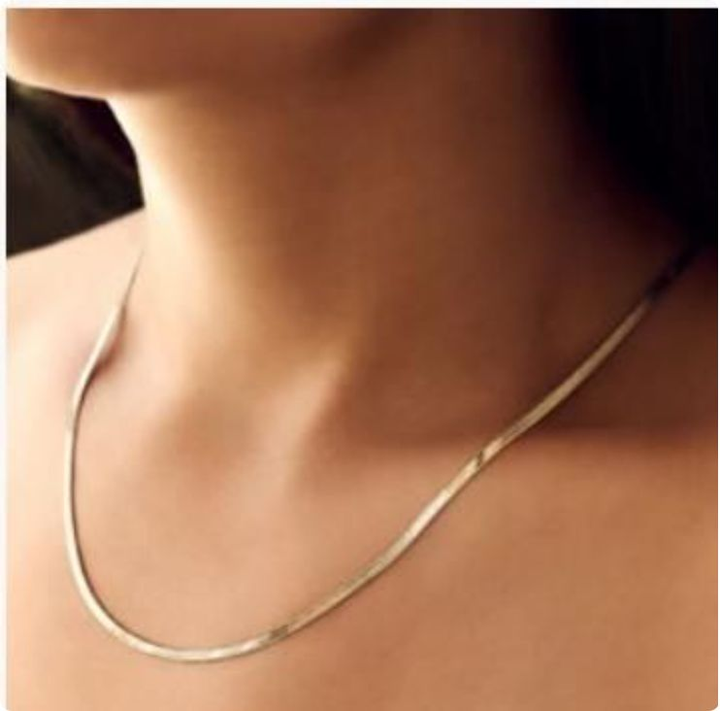
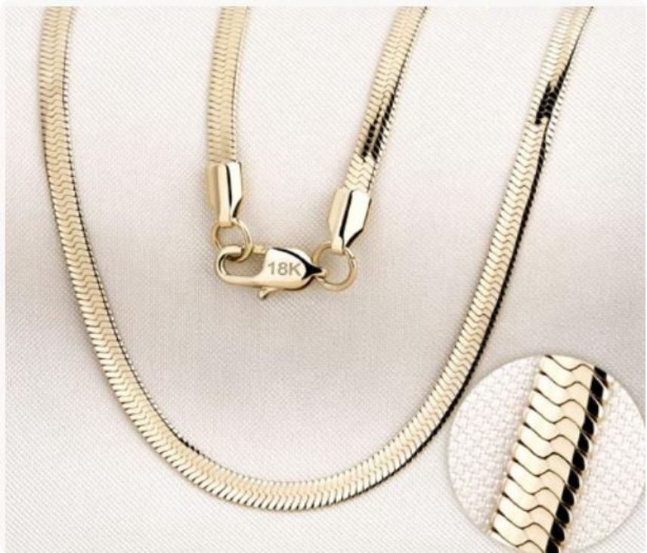
Cadena Egipcia
Drawing its name from the ancient world's most iconic civilization, the Cadena Egipcia features a bold, geometric link pattern that evokes timeless grandeur. The interlocked design lends it exceptional structural strength while maintaining a fluid, wearable drape. Available in three widths to suit bold personalities and refined tastes alike.
Egipcia — Pricing
Size
65 cm
45 cm
2 mm
$150,000
$150,000
4 mm
$200,000
—
6 mm
$290,000
—

Slide 15
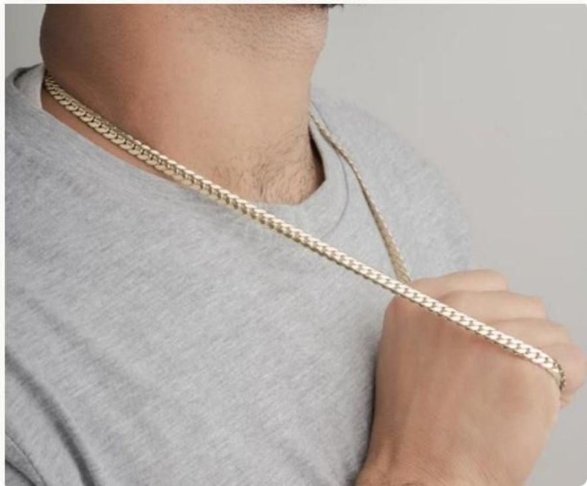
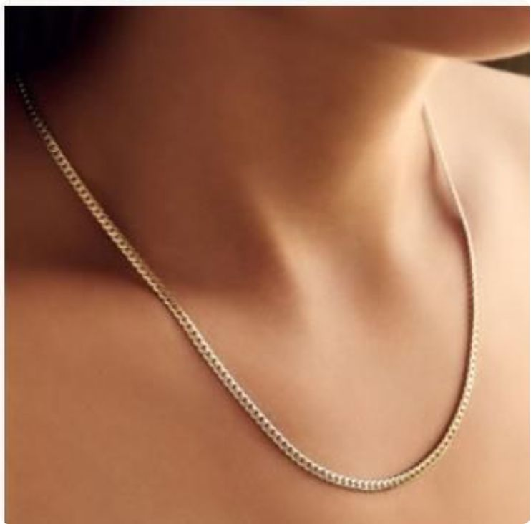
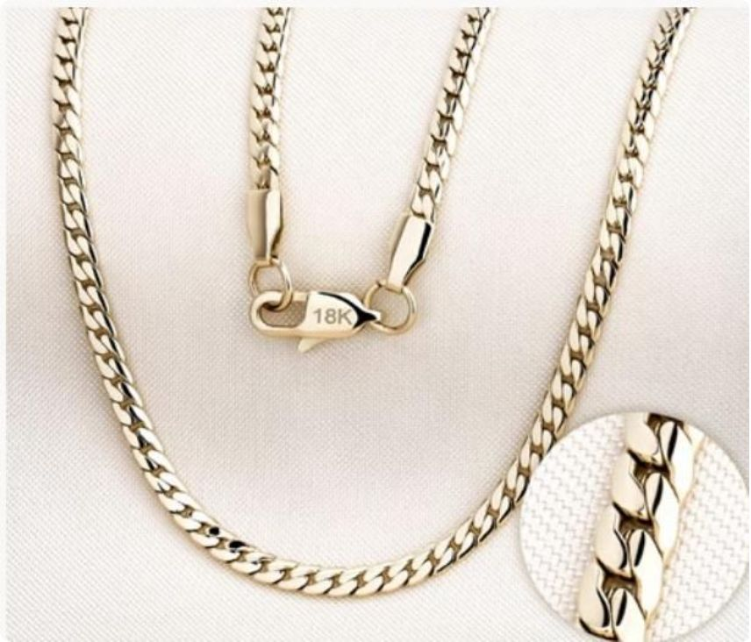
Cadena Serpiente
The Serpiente chain — named for the sinuous elegance of a serpent — is crafted from tightly fitted scale-like plates that move with extraordinary fluidity. Its smooth surface reflects light like liquid gold, creating a mesmerizing effect whether at rest or in motion. One of our most distinctive and coveted styles.
Serpiente — Pricing
Size
65 cm
45 cm
2 mm
$150,000
$150,000
4 mm
$200,000
—
6 mm
$290,000
—

Slide 16
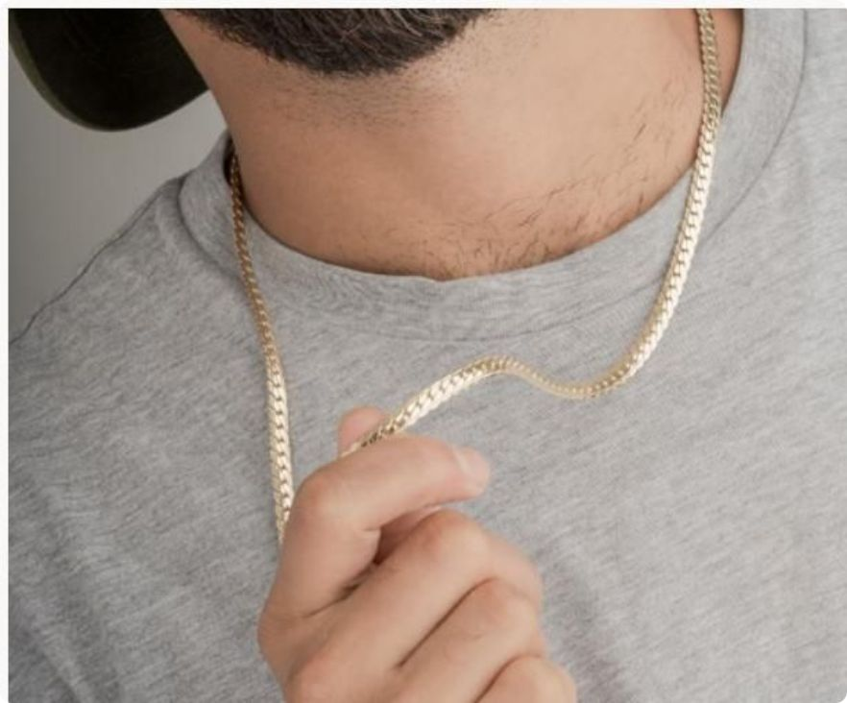
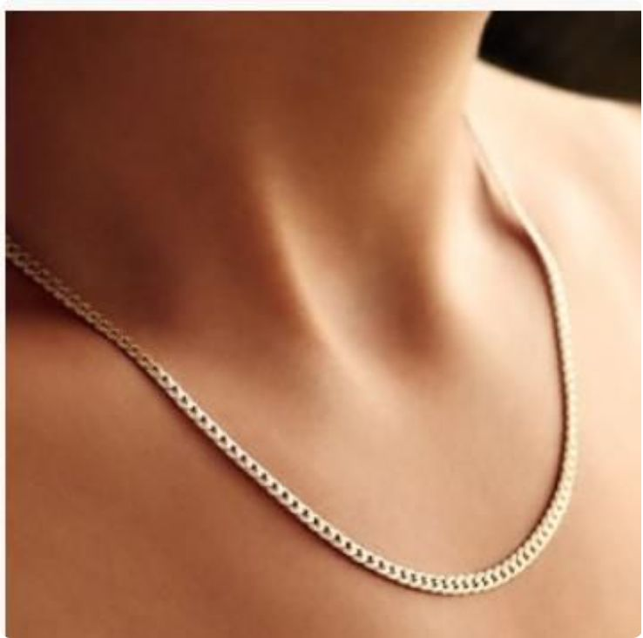
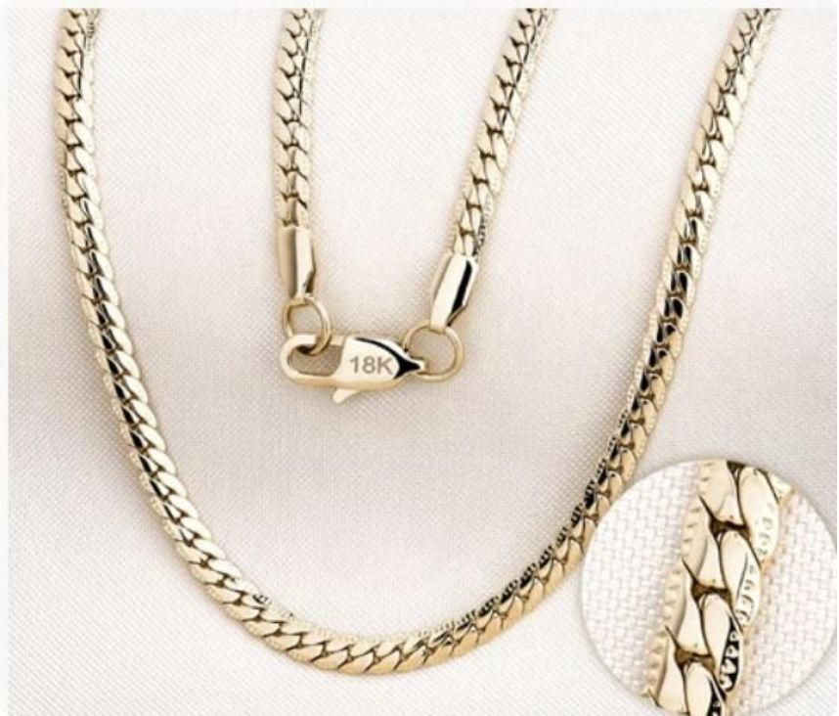
Cadena Grabada
The Grabada chain features beautifully engraved link surfaces that add depth, texture, and artisanal character to a classic silhouette. Each link is individually detailed, creating a rich visual tapestry that elevates any outfit. The subtle interplay of polished and textured surfaces makes this chain a standout choice for discerning collectors.
Grabada — Pricing
Size
65 cm
45 cm
2 mm
$150,000
$150,000
4 mm
$200,000
—
6 mm
$290,000
—

Slide 17
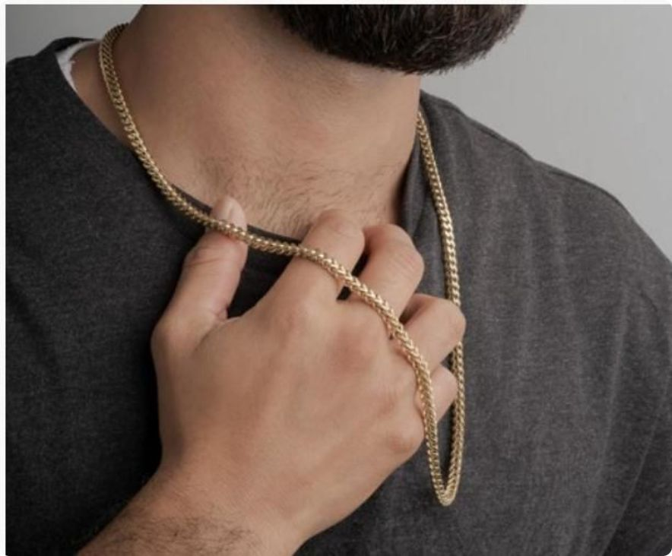
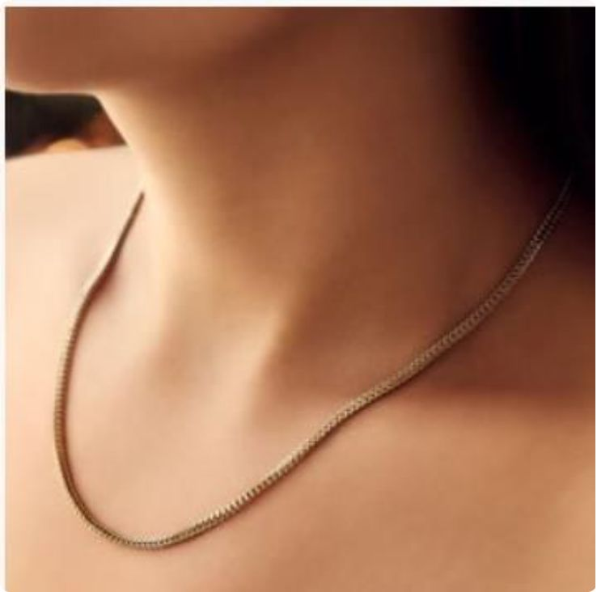
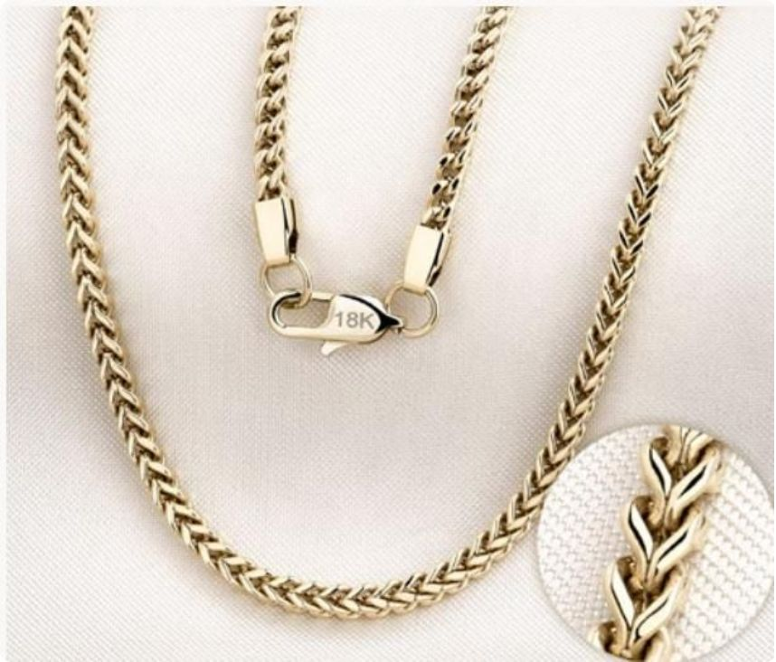
Franco Chain
The Franco chain is a heavy-link powerhouse — a beloved staple in men's jewelry known for its square, V-shaped links that interlock in a tight, dimensional weave. It lies flat yet has incredible visual weight, commanding attention without bulk. Pairs magnificently with pendants and medallions, providing a strong foundation for any statement piece.
Franco — Pricing
Size
65 cm
45 cm
2 mm
$150,000
$150,000
4 mm
$200,000
—
6 mm
$290,000
—

Slide 18
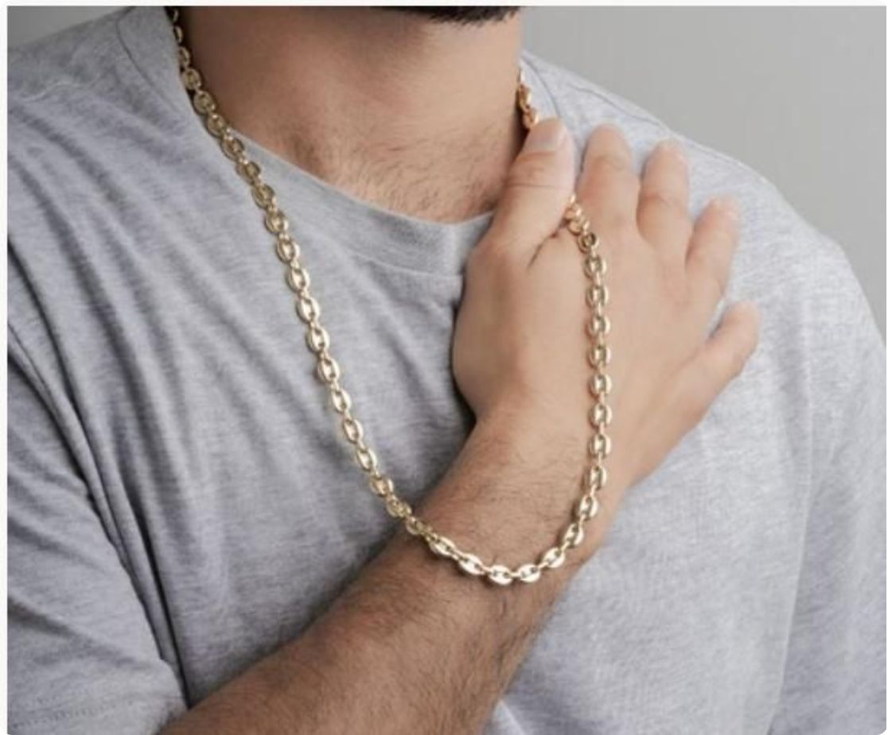
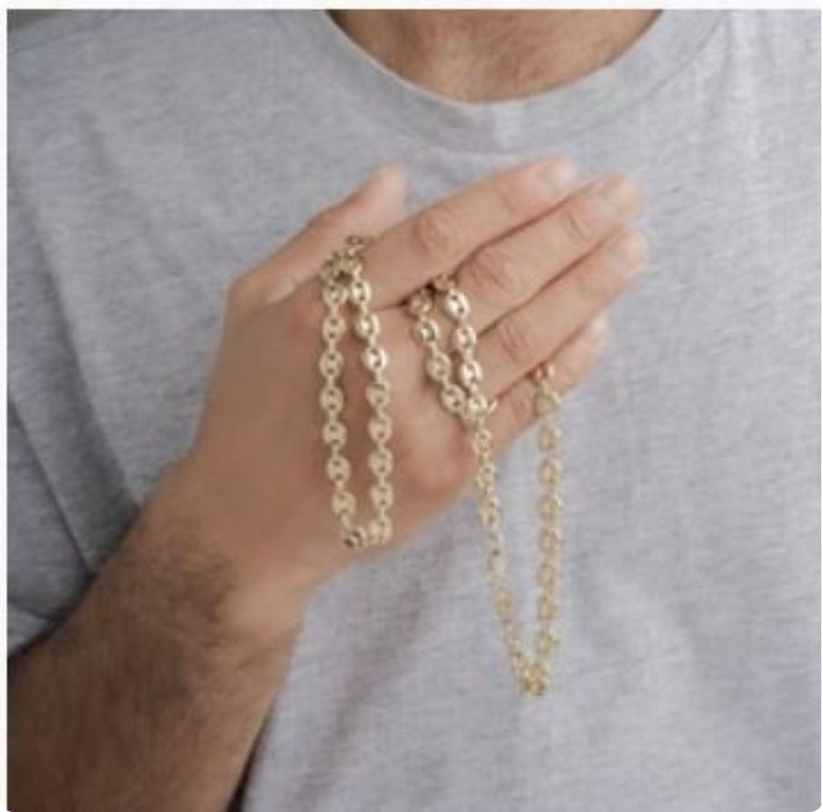
Chain Ancla
Named for the anchor — a symbol of strength and stability — this chain features large, open oval links connected by a central bar, reminiscent of a nautical chain. Its bold geometry and substantial feel make it one of our most impactful designs. Available in 4mm and 6mm for a look that commands the room.
Ancla — Pricing
Size
65 cm
4 mm
$200,000
6 mm
$290,000

Slide 19
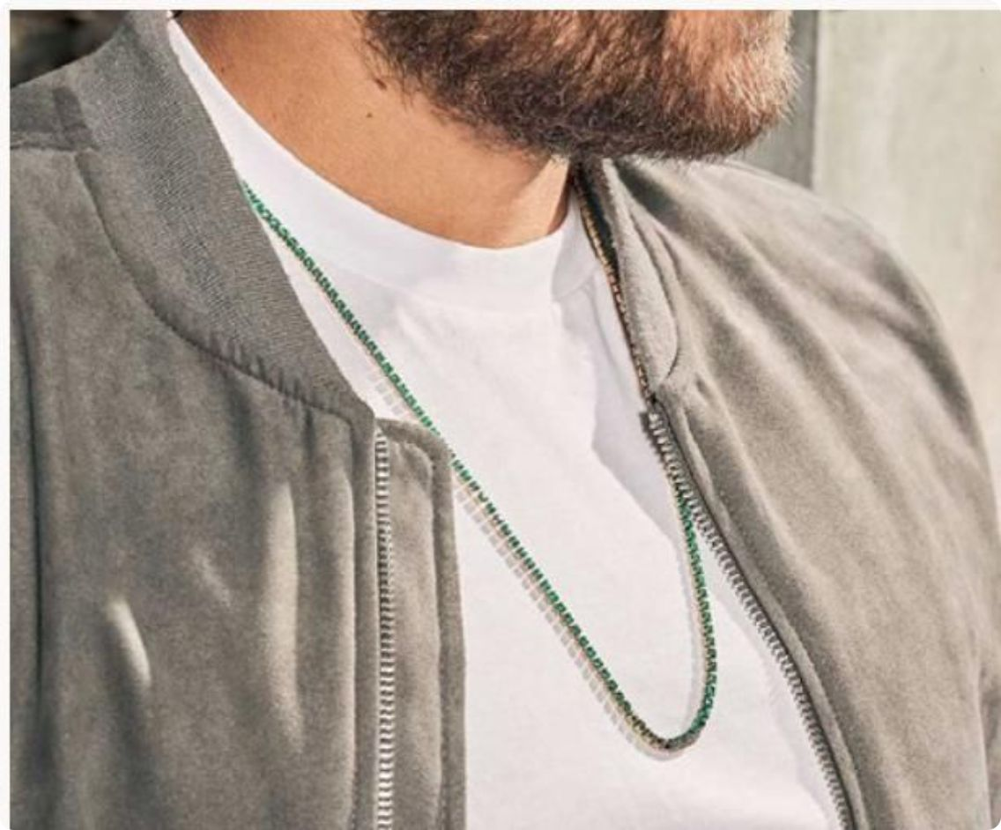
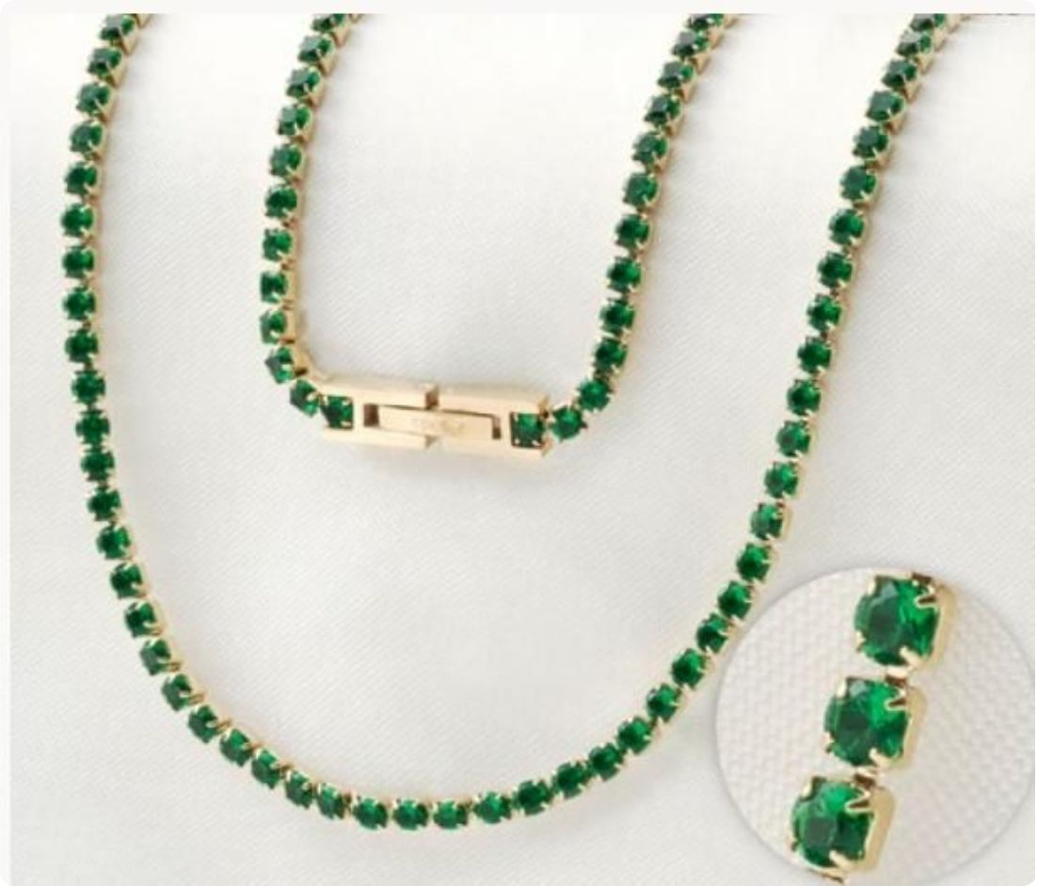
Cadena Tennis
Glamour at its most wearable — the Tennis chain is a continuous row of brilliant gemstones set in gold, creating a dazzling, uninterrupted line of color and light. Our version features exquisite green, clear, or black stones set in 18K gold-plated bezels. A single piece worn alone transforms any look from ordinary to extraordinary.
🟢 Green Stones
⚪ Clear Stones
⚫ Black Stones
Colombian emerald-inspired — vibrant and luminous
Diamond-like brilliance — timeless and versatile
Edgy, modern — dramatic contrast with gold
65 cm / 3 mm — $300,000

Slide 20
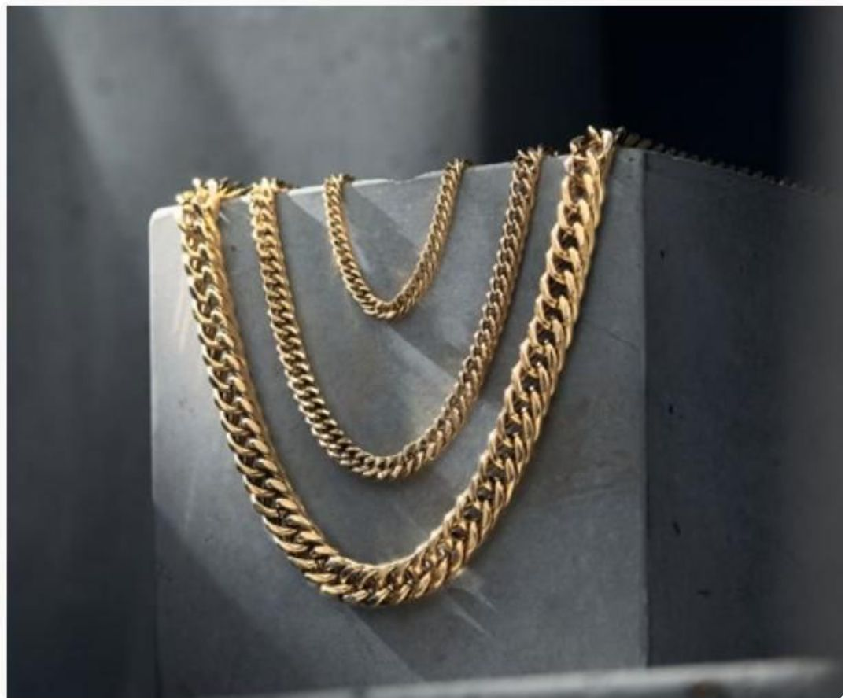
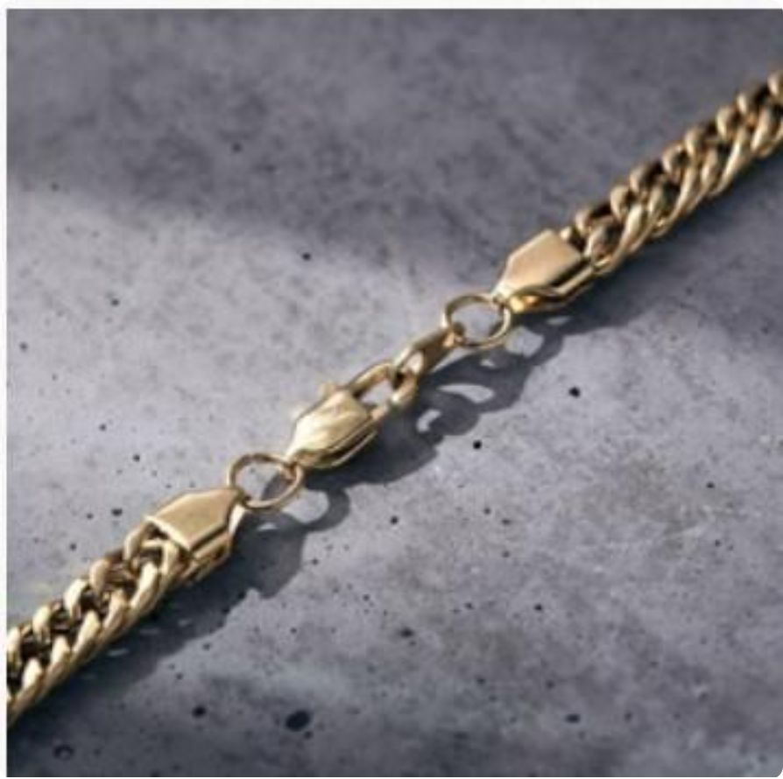
Cadena Barbada
The Barbada chain is a bold, textured heavyweight with thick, flat links that stack together creating a dense, rich surface texture. Its substantial width makes it a statement piece worn solo, while its clean geometry allows it to layer beautifully with thinner chains. A favorite among those who prefer bold, unapologetic style.
Barbada — Pricing
Size
65 cm
2 mm
$150,000
4 mm
$200,000
6 mm
$290,000

Slide 21
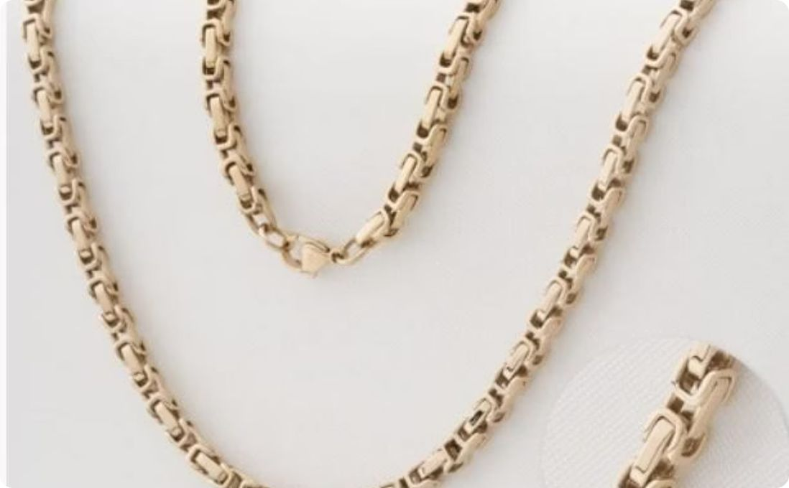
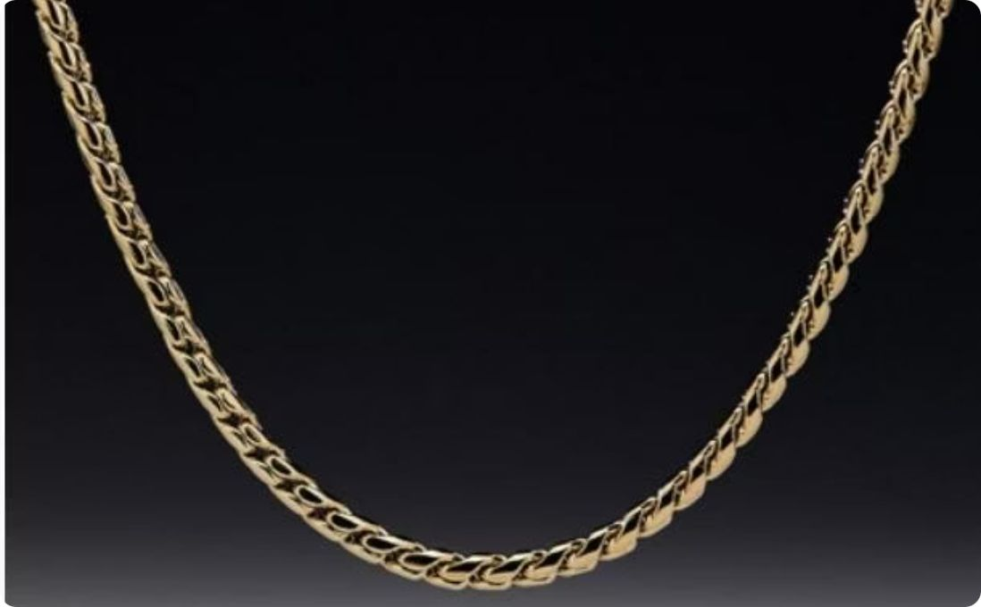
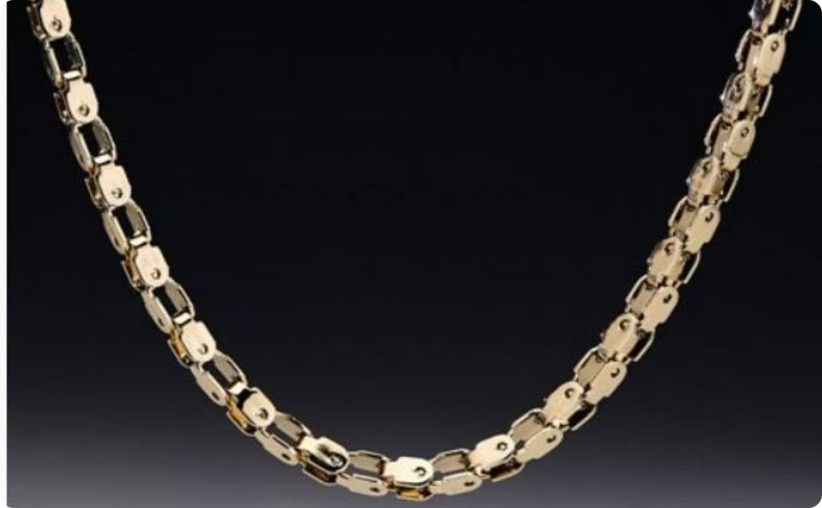
Special Chains — Rústica, Espiga, Engranaje
Rústica
Espiga
Engranaje
A raw, artisanal aesthetic with oversized irregular links — perfect for the bold individualist. 4mm / $200,000 (65 cm)
A textured herringbone weave with a distinctive raised square motif — elegant yet bold. 4mm / $200,000 (65 cm)
Inspired by mechanical gears — a unique, architectural chain for the bold and creative. 6mm / $200,000 (65 cm)

Slide 22
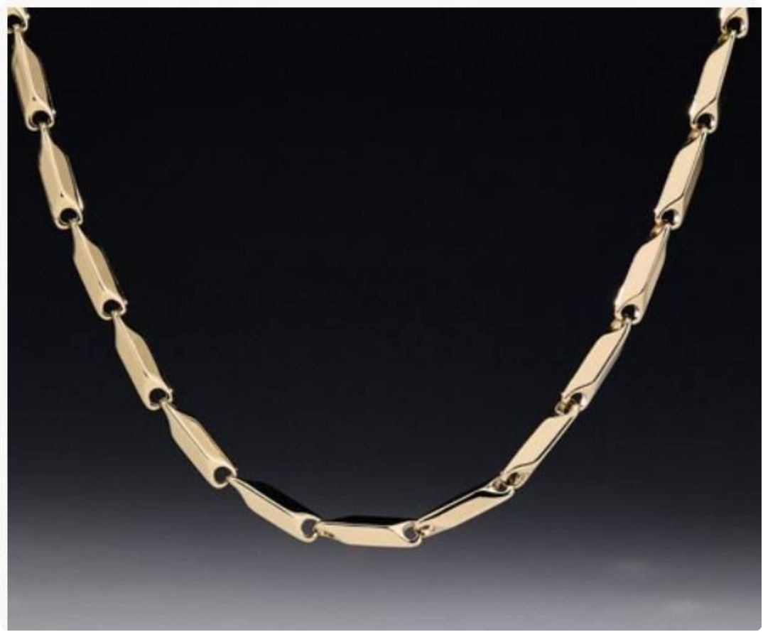
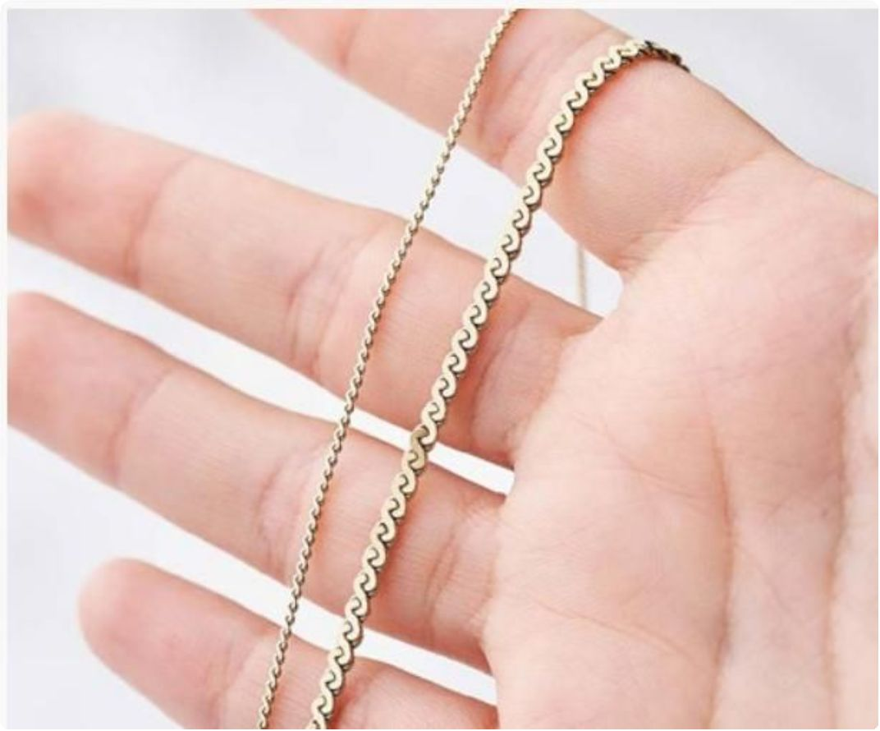
Fine Chains — Hélice, Cordón, Singapur, Espiral
Our fine chain collection caters to those who prefer delicate, refined elegance. These slim, intricate styles are perfect as standalone pieces or as layering bases for pendants and medallions. Each is stamped 18K and backed by our lifetime guarantee.
Hélice
Cordón
A helical twisted design — sculptural and fluid. 4mm / 65 cm: $200,000
A smooth, sleek cord — minimal and elegant. 1mm / 45 cm: $130,000
Singapur
Espiral
A textured Singapore weave — delicate and luminous. 1mm from $130,000
A coiled spiral — delicate yet strong. 1–2mm / 45 cm from $130,000

Slide 23
CHAPTER 2
Dijes — Pendant Collection
Our pendant collection spans a wide range of motifs — from devotional crosses to mythological icons, from equestrian elegance to bold geometric forms. Each dije is crafted in 18K titanium-fused gold and sold separately from chains, allowing you to mix and match for a truly personal expression of style. Prices listed do not include chain.

Slide 24
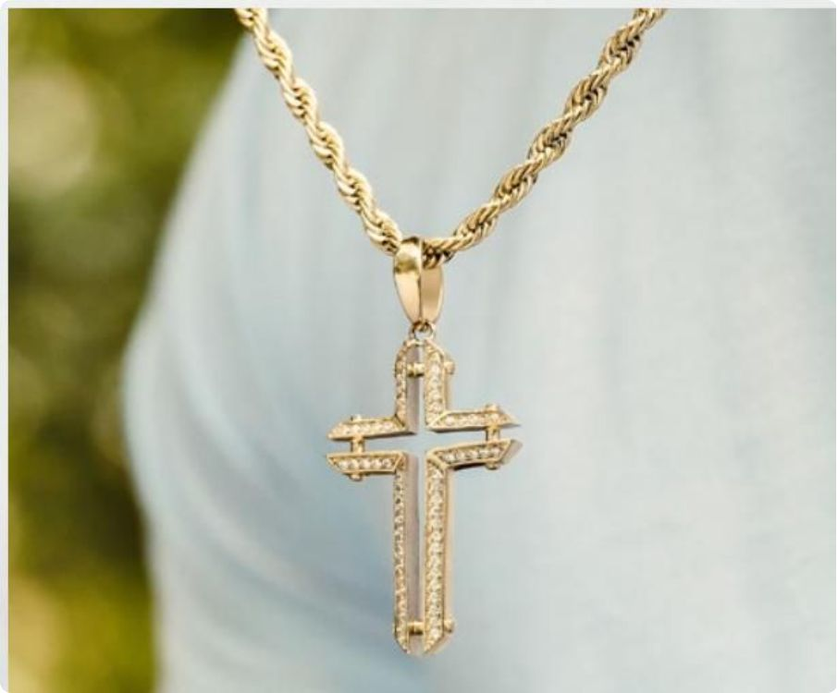
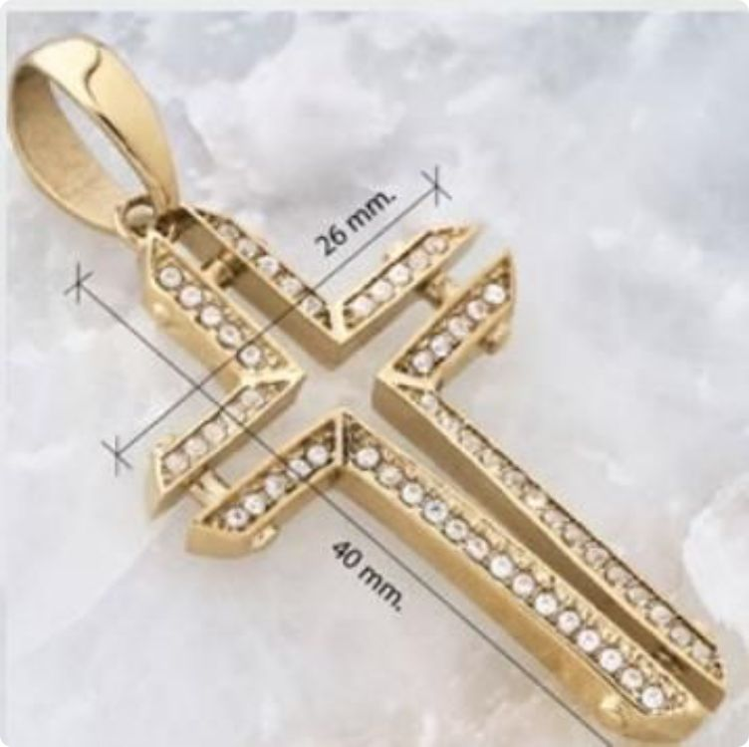
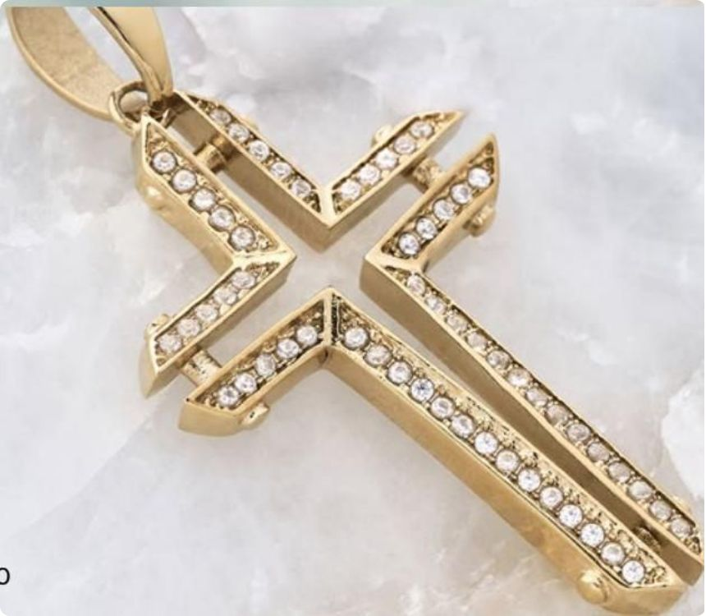
Cruz Brillante
A pavé-set cross of breathtaking luminosity — each arm encrusted with brilliant round stones that catch every ray of light. This pendant strikes a perfect balance between faith and fashion, between devotion and dazzle. Dimensions: 26mm wide × 40mm long. Price: $130,000 (chain not included)

Slide 25
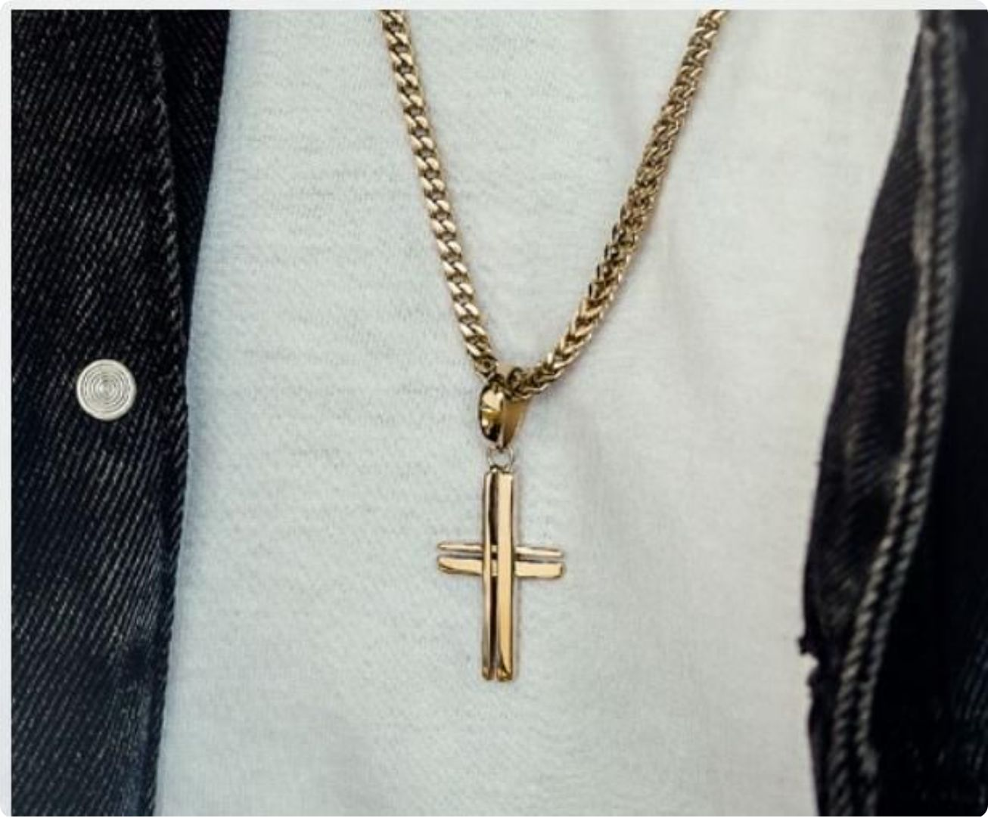
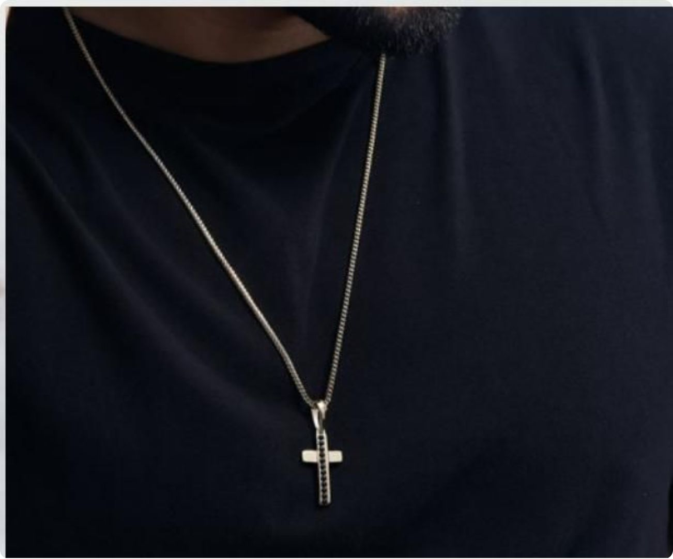
Cruz Calada & Cruz Celestial
Cruz Calada
Cruz Celestial
An open-work cross with elegant negative space — 18mm × 30mm. A refined statement of faith and craftsmanship.
$130,000 — Chain not included
Adorned with deep black stones along its arms — a celestial cross that bridges elegance and mysticism.
$130,000 — Chain not included

Slide 26
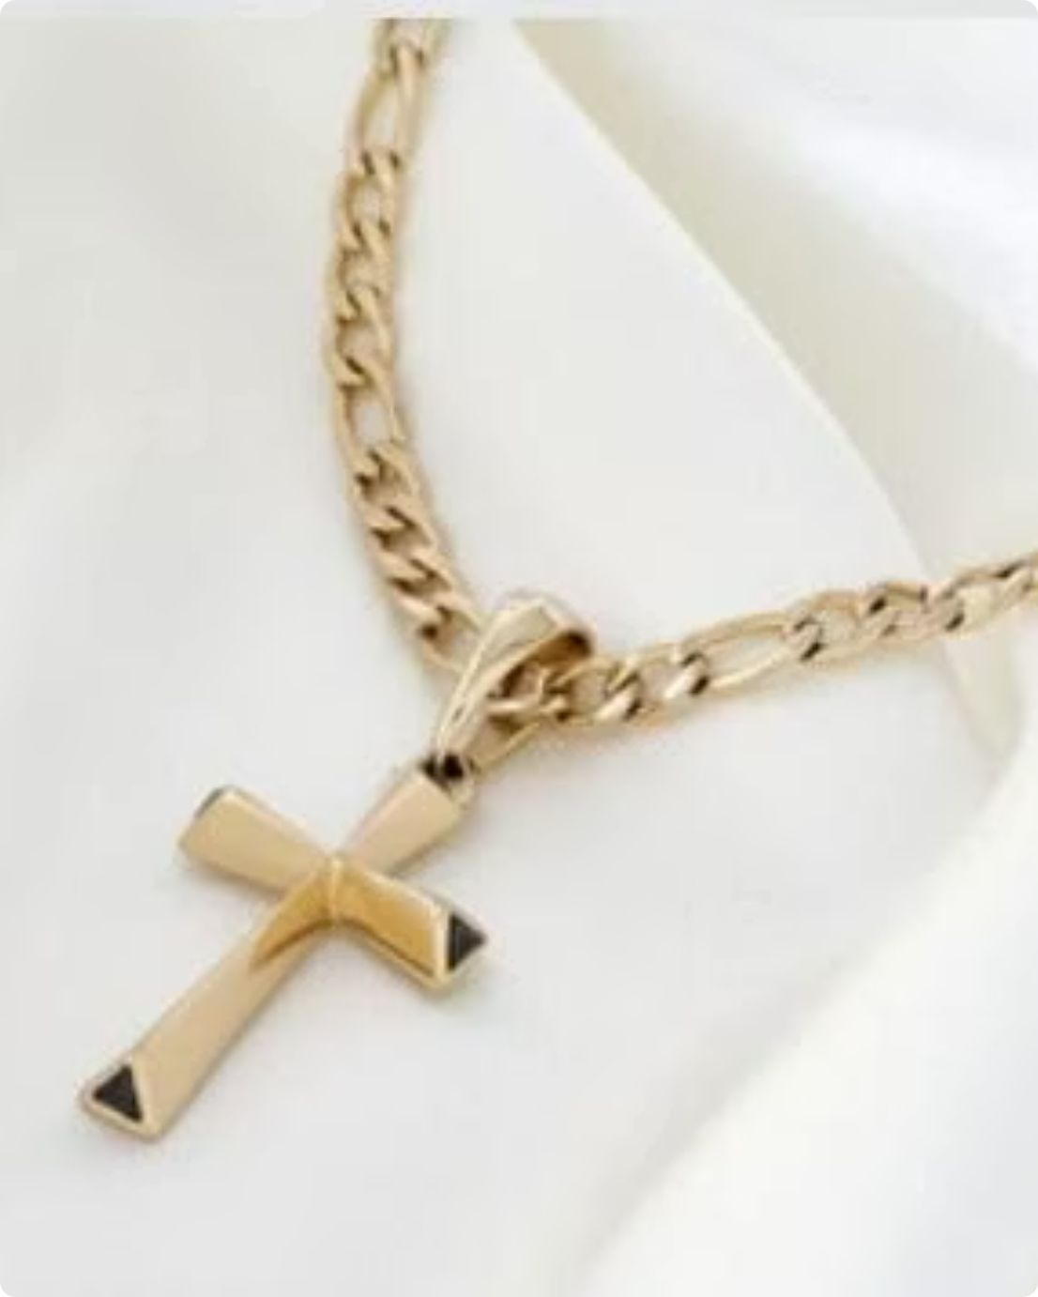
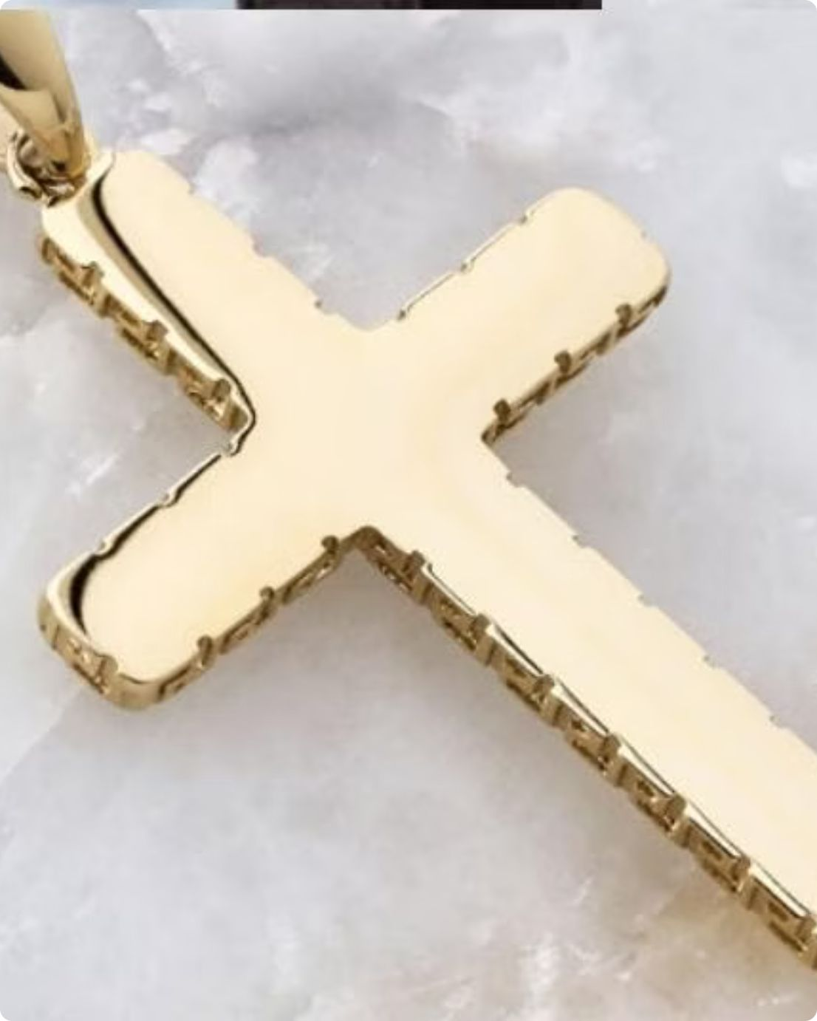
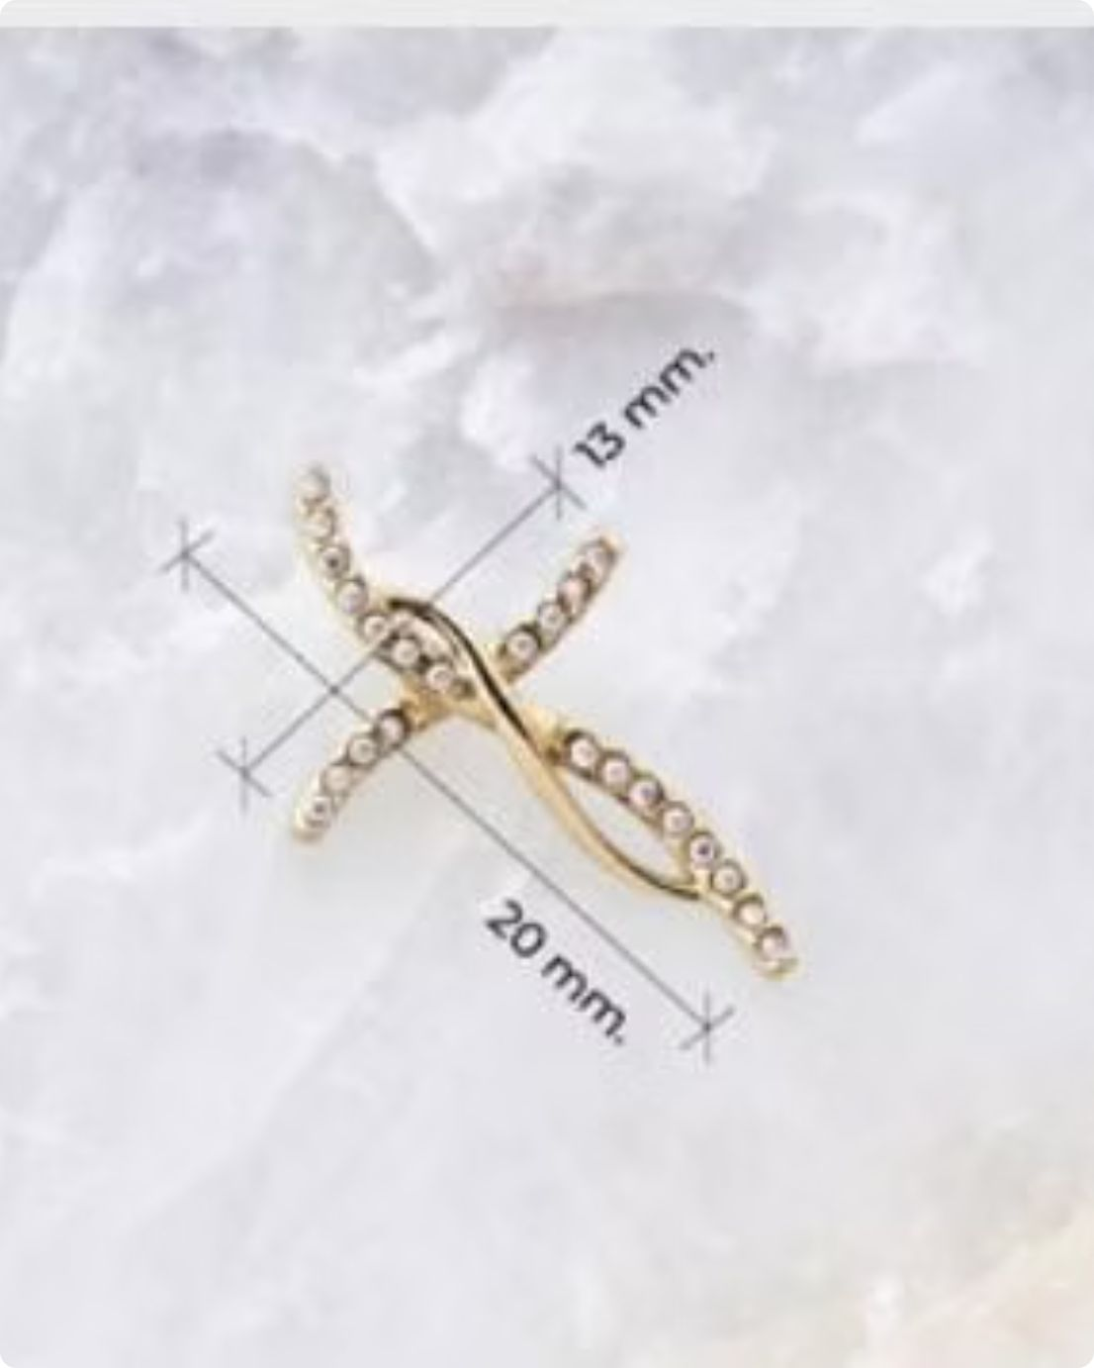
Cruz Deluxe, Cruz Grabada & Cruz Liana
Cruz Deluxe
Cruz Grabada
Cruz Liana
Faceted geometric arms with dark triangular accents — modern, architectural, bold. $130,000
Deep engraved texture on thick arms — 26mm × 40mm. Artisanal and timeless. $130,000
Delicate diamond-set arms — 13mm × 20mm. Feminine, petite, and luminous. $110,000

Slide 27

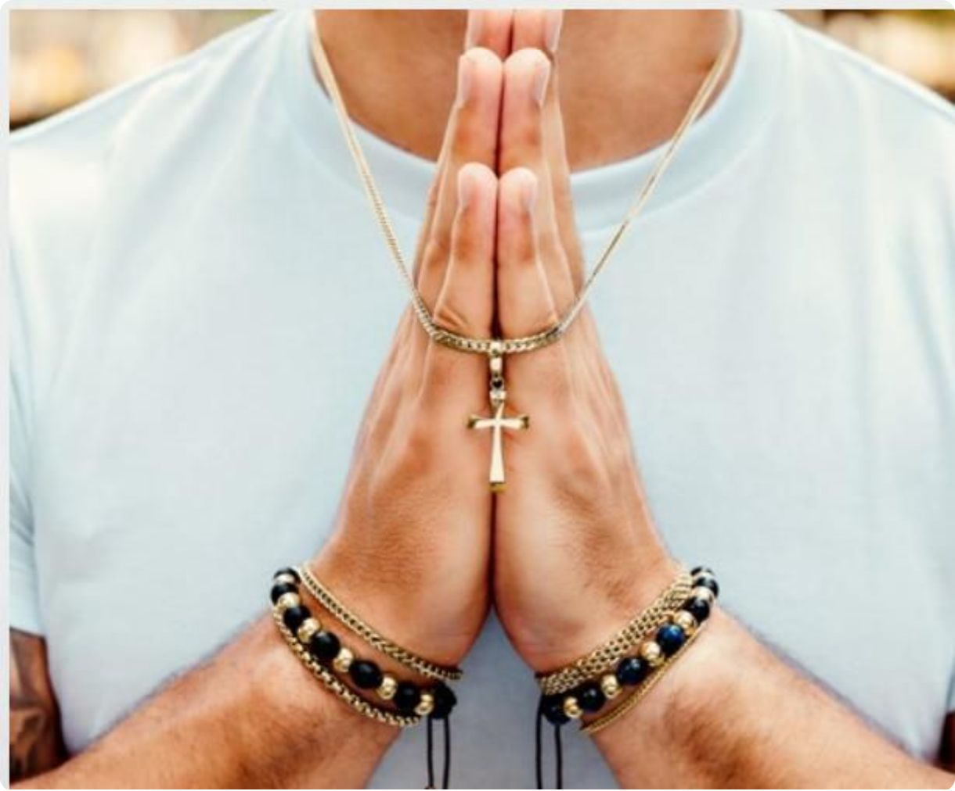

Cruz Lisa, Cruz Luxus & Cruz Suprema
Cruz Lisa
Cruz Luxus
Cruz Suprema
A clean, smooth gold cross — pure devotion without adornment. 18mm × 30mm. Worn with hands in prayer. $130,000
Stone-set edges on a compact frame — 17mm × 26mm. Luxurious detail in a refined size. $130,000
A commanding cross with textured arms and a bold central black gemstone — resting on stone, like a monument. $130,000

Slide 28



Iconic Charms — Ala, Barra, Barra Pirámides
Dije Ala (Wing)
Dije Barra
Barra Pirámides
A detailed feathered wing — 30mm × 11mm. Symbolizing freedom and flight. $130,000
Minimalist gold bar — 38mm × 4mm. Clean, architectural, endlessly versatile. $130,000
A row of obsidian-black pyramid stones set in gold — 35mm × 8mm. Edgy and architectural. $130,000

Slide 29


Charms Corazón Caballo & Caballo
Corazón Caballo
Caballo
A gold heart framing a proud horse silhouette, with gemstone-set lower edge — 24mm × 22mm. The perfect gift for equestrian souls. $130,000
A majestic, stylized horse head with flowing mane — 30mm × 21mm. Bold strength and noble grace in gold. $130,000

Slide 30




Mythological Charms — Medusa, Pegaso, Corona, Gladiador
Medusa
Pegaso
Corona
Gladiador
30mm × 30mm circular medallion — Medusa's iconic gaze framed by a Greek key border. Authority and mystique forged in gold. $130,000
28mm × 12mm — the winged stallion of mythology, rendered in exquisite relief detail. $130,000
30mm diameter — a regal crown in a circular Greek key frame. Worn by those who know their worth. $130,000
19mm × 13mm — a detailed gladiator helmet. For the warrior spirit. $130,000

Slide 31




Special Charms — Hércules, Jade, Placa, Placa Griega
Hércules
Jade
Placa
Placa Griega
A Greek key ring with a vivid blue gemstone — powerful classical design. $130,000
A large octagonal jade stone in a smooth gold frame — 25mm × 10mm. Nature's luxury. $130,000
A polished gold dog tag — 36mm × 20mm. Classic, personalized, iconic. $130,000
A rectangular pendant featuring a rich Greek key pattern — 30mm × 16mm. Heritage in gold. $130,000

Slide 32
CHAPTER 3
Medallas — Medallion Collection
Our medallion collection features circular motifs of extraordinary detail — from mythological figures to majestic animals, each medallion is a miniature work of art. Many are available with our signature Gemas Negras black stone border treatment, adding dramatic contrast and contemporary edge to classical iconography. Sold separately from chains.

Slide 33


Medalla Ancla Gemas Negras
Medalla Ancla — Black Gems
A gold anchor motif surrounded by a bold border of dark stones — 21mm × 21mm. The anchor symbolizes strength and steadfast purpose; the black gems add a contemporary edge that makes this medallion irresistibly modern.
$130,000 — Chain not included

Slide 34


Medallion Equus Black Gems & Guardiana Black Gems
Equus — Black Gems
Guardiana — Black Gems
A proud horse head rendered in circular relief, framed by a border of deep black stones — 21mm. Equestrian pride elevated to wearable art. $130,000
Medusa's fierce gaze surrounded by a ring of black stones — 21mm. Guardian of strength and beauty. $130,000

Slide 35


Medal León Black Gems & Medusa
León — Black Gems
Medalla Medusa
A majestic lion in profile, mane in full glory, surrounded by a border of dark rectangular stones — 21mm. The king of the jungle, the king of your collection. $130,000
A classic Medusa medallion with a detailed Greek key border — 20mm × 20mm. Timeless mythological power in polished gold. $130,000

Slide 36


Medal Monarca Black Gems
Monarca — Black Gems
A crown design set with black gemstones, framed in a circular border of more black gems — 21mm × 21mm. Reign over your style with unmistakable authority. This is jewelry for those who understand that true luxury is found in the details — and the confidence to wear them boldly.
$130,000 — Chain not included

Slide 37
CHAPTER 4
Brazaletes — Bangle Collection
Our bangle collection merges architectural precision with wearable luxury. From sleek minimalist bands to ornate Medusa-adorned cuffs, each bracelet is a statement of character worn on the wrist. All bangles are crafted from titanium-fused 18K gold and are fully resistant to daily life — water, sweat, and everything in between. Priced at $150,000 each.

Slide 38


Bangle Aslan & Calado
Aslan
Calado
A bold diamond-cut pattern with a dark inlaid stripe — 7mm wide, 2mm thick. Where modern edge meets refined craft. $150,000
A classic Greek key (meander) bangle — 7.5mm wide, 2.4mm thick. Ancient heritage, contemporary wrist. $150,000

Slide 39



Bracelet León, Liso & Luxor
León
Liso
Luxor
Lion/Medusa head termini with Greek key body — 11.2mm wide. Commanding presence. $150,000
The perfect minimalist bangle — 6.4mm wide, silky smooth finish. Timeless simplicity. $150,000
A striking inlay of vivid green stones along the band — 5mm wide. Inspired by Egyptian opulence. $150,000

Slide 40




Bangle Medusa & Pantera
Medusa Bangle
Pantera Bangle
Open-cuff bangle with Medusa head finials and Greek key body — 11.2mm. $150,000
Two prowling panther heads face each other across the wrist — 8.5mm wide. Fierce elegance. $150,000

Slide 41





Leather Bracelets — Ancla, Caballo, King, Lusso, Magno
Our leather braid bracelets combine black braided cord with 18K gold-plated medallions and accents — a perfect fusion of rugged and refined. Each piece is priced at $199,900.
Ancla
Caballo
King
Lusso
An anchor medallion in a black bezel on braided leather — maritime strength on the wrist.
A horse head medallion flanked by gold horseshoes — equestrian spirit in leather and gold.
A circular crown medallion on braided leather — for those who wear their authority quietly.
Medusa medallion with Greek key segments — Italian luxury references on braided black leather.
Magno
A lion's head medallion with gold chain links and braided leather — authority in every detail.

Slide 42

CHAPTER 5
Anillos — Ring Collection
Our ring collection is as diverse as the personalities who wear them — from the massive statement of the Apolo to the sleek minimalism of the Esparta, from the Cuban link Cubano to the emerald-crowned Panal. Each ring is titanium-fused 18K gold, stamped and guaranteed for life. Find the perfect ring — or the perfect stack.

Slide 43




Ring Apolo & Colossal
Apolo
Colossal
Wide rectangular white plate with diamond borders, set in a braided gold base — 10mm × 6mm. Powerful and refined. $150,000
A bold thick band with a channel of brilliant clear stones — 4.4mm wide. Subtle luxury with maximum impact. $150,000

Slide 44



Ring Cubano, Esparta & Olimpus
Cubano
Esparta
Olimpus
The Cuban link pattern transferred to a ring — 7.8mm wide, bold and unmistakable. $120,000
A warrior's ring — 7mm wide woven texture, stamped 18K inside. $120,000
Channel-set stones on a sleek gold band — 5.5mm wide. Where strength meets elegance. $150,000

Slide 45



Ring Panal, Titán & Zeus
Panal
A breathtaking Colombian emerald set in a diamond-bordered honeycomb-textured band — 17mm wide. Nature's finest, in gold. $150,000
Zeus
Titán
Chain-link texture with a brilliant diamond-set band — 8mm wide. The most powerful ring in our collection. $150,000
A premium woven-texture band with smooth interior — 7.2mm wide. Understated power. $120,000

Slide 46

CHAPTER 6
Pulsos — Bracelet Collection
Our pulso collection is the most extensive in the catalog — featuring every major chain style transposed to bracelet form, complete with optional engraved gold plates for personalization. From the classic Cuban link to the delicate Tennis, every pulso is stamped 18K and available with or without a central plate. Stack them, mix them, wear them daily — they are built for it.

Slide 47


Pulso Cubano
Cubano — Pricing
Size
Without Plate
With Plate
2 mm
$100,000
$130,000
4 mm
$130,000
$160,000
6 mm
$150,000
$190,000

Slide 48


Pulso Carter & Chinesco
Carter
Chinesco
Size
Plain
+ Plate
Size
Plain
+ Plate
2mm
$100,000
$130,000
4mm
$130,000
$160,000
4mm
$130,000
$160,000
6mm
$150,000
$190,000
6mm
$150,000
$190,000

Slide 49



Bracelet Franco, Grabado & Serpiente
Franco
Grabado
Serpiente
2mm from $100,000 — 4mm from $130,000 — 6mm from $150,000 (+ plate option)
2mm from $100,000 — 4mm from $130,000 — 6mm from $150,000 (+ plate option)
2mm from $100,000 — 4mm from $130,000 — 6mm from $150,000 (+ plate option)

Slide 50


Bracelet Ancla & Veneciano
Ancla
Veneciano
Size
Plain
+ Plate
Size
Plain
+ Plate
4mm
$130,000
$160,000
2mm
$100,000
$130,000
6mm
$150,000
$190,000
4mm
$130,000
$160,000
6mm
$150,000
$190,000

Slide 51


Pulso Lazo
Lazo — Rope Bracelet Pricing
Size
Price
2 mm
$100,000
4 mm
$130,000
6 mm
$150,000
No plate option — the rope chain speaks for itself.

Slide 52



Pulso Tennis
The Tennis bracelet is the crown jewel of wrist accessories — a continuous row of brilliant stones set in 18K gold-plated bezels. Available in classic round-cut diamonds, vibrant Colombian emeralds, rectangular stones, square-cut gems in black, green, and blue — there is a Tennis for every taste and every occasion. All priced at $150,000.

Slide 53




Tennis Rectangular & Square
Tennis Rectangular
Tennis Cuadrado
Elongated rectangular stones in black or green — dramatic, modern, bold. $150,000
Square-cut stones in green, black, or blue — rich color saturation on gold. $150,000

Slide 54


Luxury Bracelets — Monarca, Rústico, Jade, Zeus, Fénix, Centurión, Titán
Monarca
Rústico
Jade
Crown medallion on Cuban links — $200,000
Bold rectangular links, optional plate — from $150,000
Green emerald stone on Cuban links — $200,000
Zeus
Fénix
Centurión
Gold chain with green inlay central bar — $200,000
Black band with gold oval links — $200,000
Gold + black segments with green stones — $200,000
Titán
Link bracelet with textured gold plate — $200,000

Slide 55
CHAPTER 7
Pulsos Tejidos — Macramé Bracelets
Our tejido collection brings together the warmth of handcrafted macramé cord with the brilliance of 18K gold-plated chain segments. Available in red and black cord options, these bracelets carry a casual, layerable energy that pairs beautifully with gold bangles and beaded pulsos. Offered in Carter, Cubano, Chinesco, Franco, Ancla, and Veneciano chain styles — plus a special placa version for personalization. Starting from $60,000.

Slide 56



Tejidos — Carter, Cubano, Chinesco
Carter Tejido
Cubano Tejido
Chinesco Tejido
4mm: $60,000 — 6mm: $70,000
4mm: $60,000 — 6mm: $70,000
4mm: $60,000 — 6mm: $70,000

Slide 57




Woven — Franco, Ancla, Veneciano, Tejido Placa
Franco Tejido
Ancla Tejido
Veneciano Tejido
Tejido Placa
4mm: $60,000 / 6mm: $70,000
4mm: $60,000 / 6mm: $70,000
4mm: $60,000 / 6mm: $70,000
6mm: $70,000

Slide 58

CHAPTER 8
Pulseras — Beaded Bracelet Collection
Our pulseras collection celebrates the timeless beauty of natural stone beads paired with 18K gold-plated accents. From vibrant green malachite to deep blue lapis lazuli and sleek black onyx, each bead carries its own character and energy. Available in several configurations — Intercalada, Intercalada Doble, Completa, and Trenzada — and in the sub-collection of Balines with Centrales and Laterales arrangements. All backed by our lifetime guarantee.

Slide 59


Pulsera Intercalada
Intercalada — Available Stones
🟢 Green
🔵 Blue
Malachite — vibrant natural green
Lapis Lazuli — deep celestial blue
⚫ Black
Onyx — sleek, powerful black
6mm: $110,000 — 6mm + plate: $140,000

Slide 60



Bracelet Intercalada Doble
Intercalada Doble
Double-row alternating stones and gold beads — a richer, more substantial look than the single Intercalada. The doubling of the stone rows creates a bracelet with real visual presence on the wrist, available in the same three stone options.
6mm: $110,000

Slide 61


Balines Bracelets — Central & Lateral
Balines Centrales
Balines Laterales
Gold beads concentrated in the center of the bracelet, flanked by stone beads on either side — a focused, elegant composition. 6mm: $110,000
Gold beads positioned on the flanks of the bracelet with stones in the center — an inversely elegant framing effect. 6mm: $110,000

Slide 62




Bracelet Completa & Trenzada
Completa
Trenzada
An all-gold bead bracelet — pure, radiant, and powerful. Optional plate for personalization.
4mm: $150,000 / 6mm: $200,000 / 6mm + plate: $230,000
Gold beads woven into braided cord — a fusion of texture and shine. Available in red and black.
4mm: $210,000 / 6mm: $250,000

Slide 63

ESMERALDAS COLOMBIA
Colombian Emeralds
Colombia is the world's premier source of emeralds — responsible for over 70% of global production — and our collection proudly features these extraordinary gemstones. Colombian emeralds are renowned for their unparalleled depth of color: a rich, saturated green with a warm, slightly yellowish hue that is utterly distinct from stones mined elsewhere in the world. This distinctive color — known in the trade as "Colombian green" — is the result of trace amounts of chromium and vanadium found uniquely in the Boyacá region's geological formations.
You will find Colombian emeralds featured throughout our catalog — in the Panal ring, the Cruz con Gemas Verdes, the Tennis necklace, the Jade pendant, the Luxor bracelet, the Centurión pulso, and more. When you choose a piece with Colombian emeralds, you are wearing a fragment of one of the world's most celebrated natural treasures, elevated by 18K gold. Visit us at EsmeraldasColombia.com to learn more.

Slide 64

Why Choose Us — The Full Picture
Certified Materials
Lifetime Warranty
18K gold fused on premium titanium
Includes lab certificate and coverage
Daily Durability
Italian Aesthetics
Resists water, sweat, and chemicals
Same color and shine as solid gold
Every decision we make — from the titanium substrate we choose to the saline chamber tests we run — is oriented toward one goal: delivering a piece of jewelry that you will wear with pride for the rest of your life. Our Oro Laminado is not a compromise between cost and quality. It is an innovation that delivers both simultaneously. Laboratory certified. Lifetime guaranteed. Indistinguishable from solid 18K Italian gold.

Slide 65





Shop Our Full Collection
Browse hundreds of styles — chains, pendants, medallions, bangles, rings, pulsos, and beaded bracelets — all crafted in certified 18K titanium-fused gold with a lifetime guarantee. Resistant to the sea, the pool, the gym, and everything life throws at you.
18K
100%
Gold Layer
Certified
Italian-quality 18K gold fused on titanium — not a liquid bath
Every piece comes with a laboratory certificate
∞
Guarantee
Lifetime warranty — unconditional, written, and honored

